Slide 1
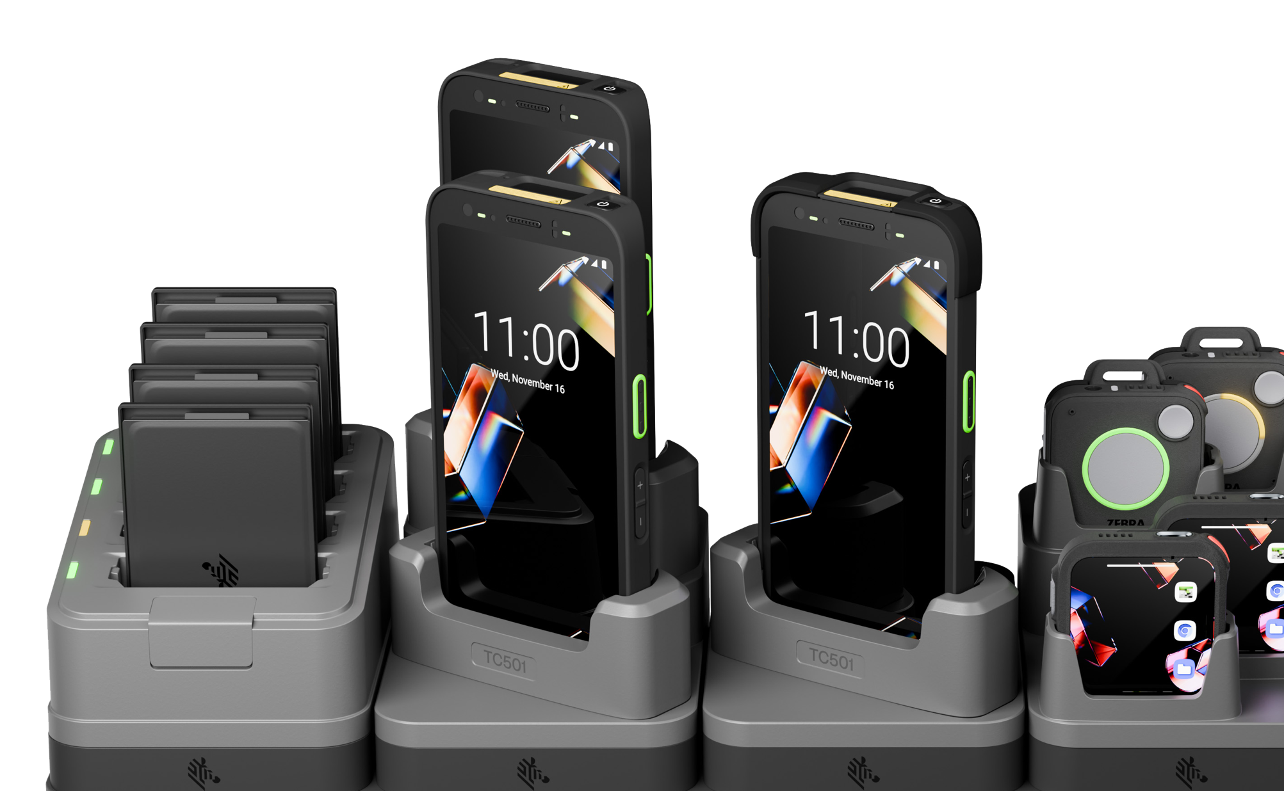

The next-generation ShareCradle
The future of adaptable charging
June 23, 2026

Slide 2
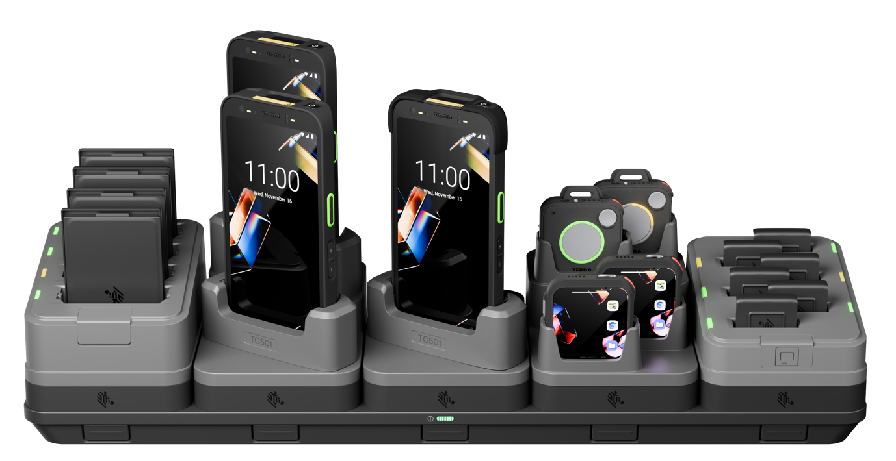
Introducing the next-generation ShareCradle
Completely modular design allows you to charge it all
What can you do with the
next-generation ShareCradle?
Mix-and-match on a single modular platform
Build the charging cradles
you need for the Zebra mobile
and wearable computers you own today
Simply swap cradle cups to support the new devices you
buy tomorrow
ZEBRA TECHNOLOGIES

Slide 3

SHARECRADLE CHARGING SYSTEM benefits
A new level of simplicity, adaptability, sustainability, and future-proofing

Slide 4
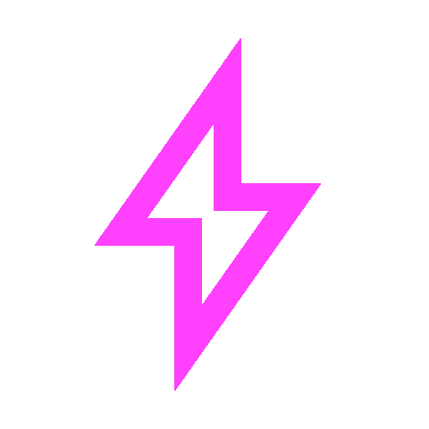



Designed to outperform the first-generation ShareCradle
Faster charging
Smaller footprint
Leverages today’s fast-charging technologies to reduce device downtime
Enables charging in more locations while increasing backroom capacity
Easier to upgrade
More sustainable
Snap-on cradle cups and a common rack mount make it easy to support new devices
Reduces electronic waste and the number of required charging bases
Zebra Technologies

Slide 5
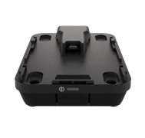
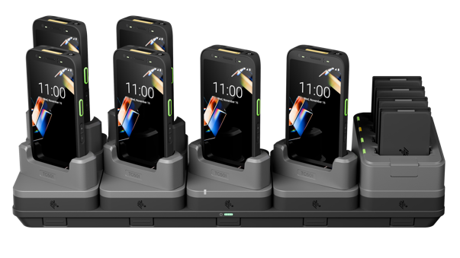
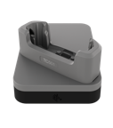
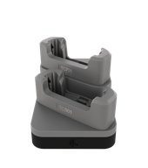
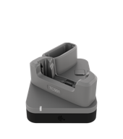
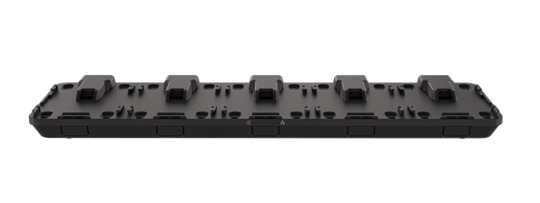
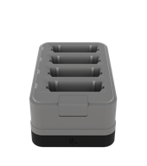
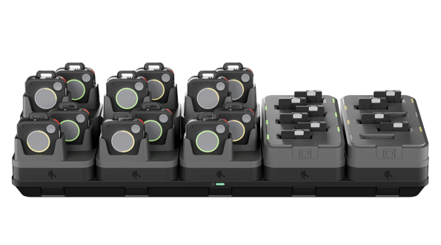
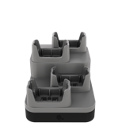
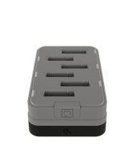
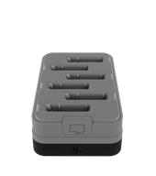
How it works
Modular platform lets you add components today—and adapt for tomorrow
Next generation modular future-proof design redefines
adaptable charging
1. Choose a base
2. Add cradle cups
3. Mix and match
FOR HANDHELD MOBILE COMPUTERS
1 Device Fast Charge
1-Slot Base
(Charge + Ethernet)
2 Device Charge
1 Device /
1 Battery Charge
Handheld Mobile Computer ShareCradle
4 Battery Charge
Move incoming shipments from dock to stock faster
5-Slot Base
(Charge Only, Charge + Ethernet, or Fast Charge)
FOR WEARABLE MOBILE COMPUTERS
4 Device Charge
6 WS101 Battery Charge
Wearable Mobile Computer ShareCradle
6 WS301 Battery Charge
ZEBRA TECHNOLOGIES
Notes:
• All ShareCradle cups can be used as standalone chargers, no base required.
• 2- and 4-Device Charge does not support Ethernet.

Slide 6

Tool-free setup
Easy to upgrade
What once took minutes now takes seconds. Cradle cups snap on and off—and tools, rewiring and special skills are no longer required.
Upgrading or adding new types of devices is easy. Simply swap cradle cups—no need to replace the entire charging system.
A new level of simplicity
Designed to reduce setup time today and protect your investment over time

Slide 7

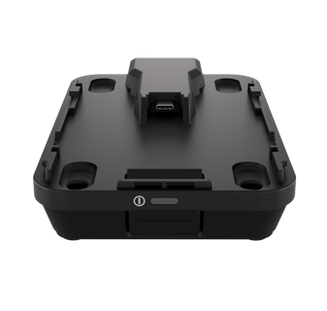
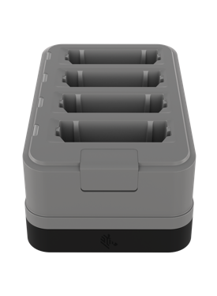
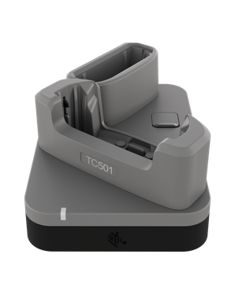
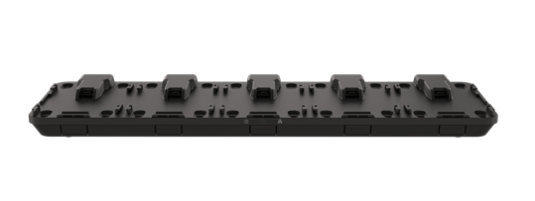
A new level of adaptability
Charging configurations for any workspace
Bases for
backroom charging
Desktop and countertop bases
Customize with cradle cups
Standalone cradle cup charging
Rack-mountable 5-slot bases designed for backroom environments:
Charge only
Charge + Ethernet
Fast Charge
Single-slot base provides device charging and a hardwired Ethernet connection.
Snap-on cradle cups fit specific devices and batteries.
Double backroom charging capacity with double-density cups.
Use cradle cups without a base to charge devices and batteries anywhere via a USB-C cable and a country-specific 45W power adapter.
.
ZEBRA TECHNOLOGIES

Slide 8
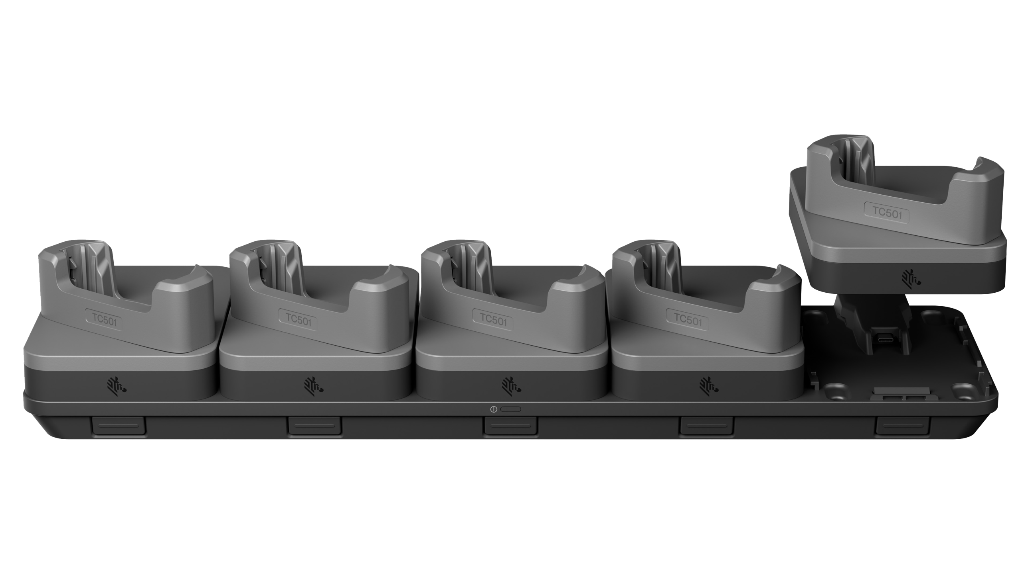
Charge from 0–70% in just 45 minutes
New FAST CHARGING
Three flexible ways to fast-charge your Zebra devices:
45 W USB
wall adapter
Standalone single-device cradle cup
5-slot fast-
charge base
Charge faster. Work longer. Maximize ROI.

Slide 9
A new level of sustainability and future-proofing
Engineered to reduce materials and electronic waste—without sacrificing performance
High-density device cradles
Effortless upgrades
Adaptive charging
Smaller power supplies
Double-density cradles cut the number of bases and accessories required—reducing materials and long-term cost.
The modular, toolless design supports all upcoming mobile devices, allowing for quick, easy, and inexpensive cup swaps to support new devices as your tech evolves.
Automatically adjusts power levels to maximize battery life, minimizing the size and cost of the battery pool—and electronic waste.
65%+ smaller and 60% lighter—substantially reducing shipping costs and space requirements in the backroom, on a desk and more.
ZEBRA TECHNOLOGIES

Slide 10
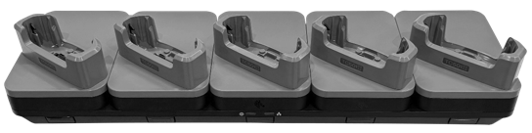
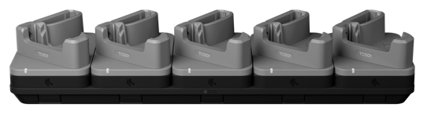
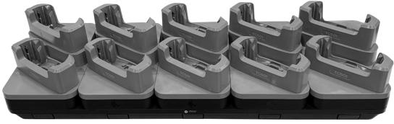
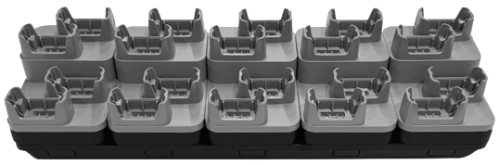
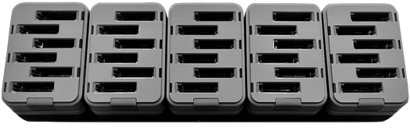
Save time and money with pre-configured kits
10 Handheld Devices
Available for the most common multi-slot options:
5 Handheld Devices with Fast Charging
Benefits
5 Handheld Devices + 5 Spare Batteries
Major savings with cost-effective migration
Ordering made simple with a complete solution under one SKU
Turnkey kits built for instant setup
More sustainable with less packaging material
10 Handheld Devices
20 Wearable Devices
30 Spare Batteries for Wearable Devices
ZEBRA TECHNOLOGIES

Slide 11

Increase charging flexibility,
functionality and sustainability
—while cutting equipment and
maintenance costs. Get it all with Zebra’s new ShareCradle system.
Notes:
How will the next-generation ShareCradle benefit your business?
Drive charging flexibility, functionality and sustainability up … while driving maintenance, equipment and energy costs down.

Slide 12

Questions?
ZEBRA and the stylized Zebra head are trademarks of Zebra Technologies Corp., registered in many jurisdictions worldwide. All other trademarks are the property of their respective owners. ©2026 Zebra Technologies Corp. and/or its affiliates. 06/23/2026

