Slide 1
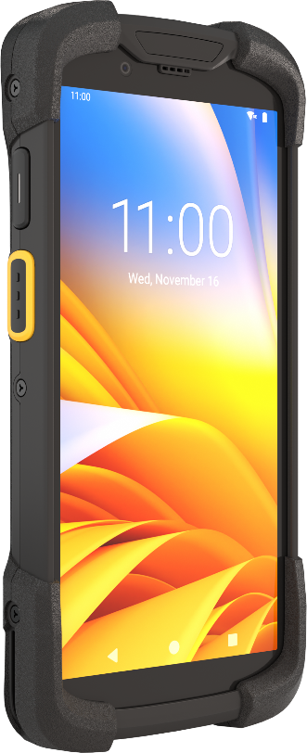

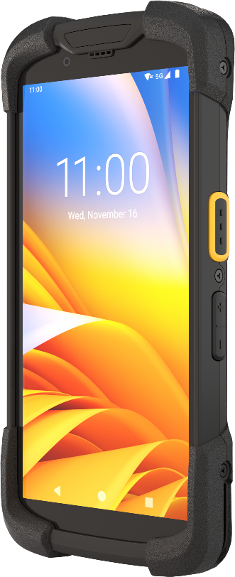
TC73/TC78
Mobile Computer
TC73/TC78
Mobile Computer
The ultra-rugged mobile computer re-imagined for the new age of mobility
The ultra-rugged mobile computer re-imagined for the new age of mobility
May 2023

Slide 2
Agenda
Why Zebra?
Challenge and Solution
Vertical Markets and Applications
Key Features
Accessories
Zebra Mobility DNA
Zebra Services
2

Slide 3
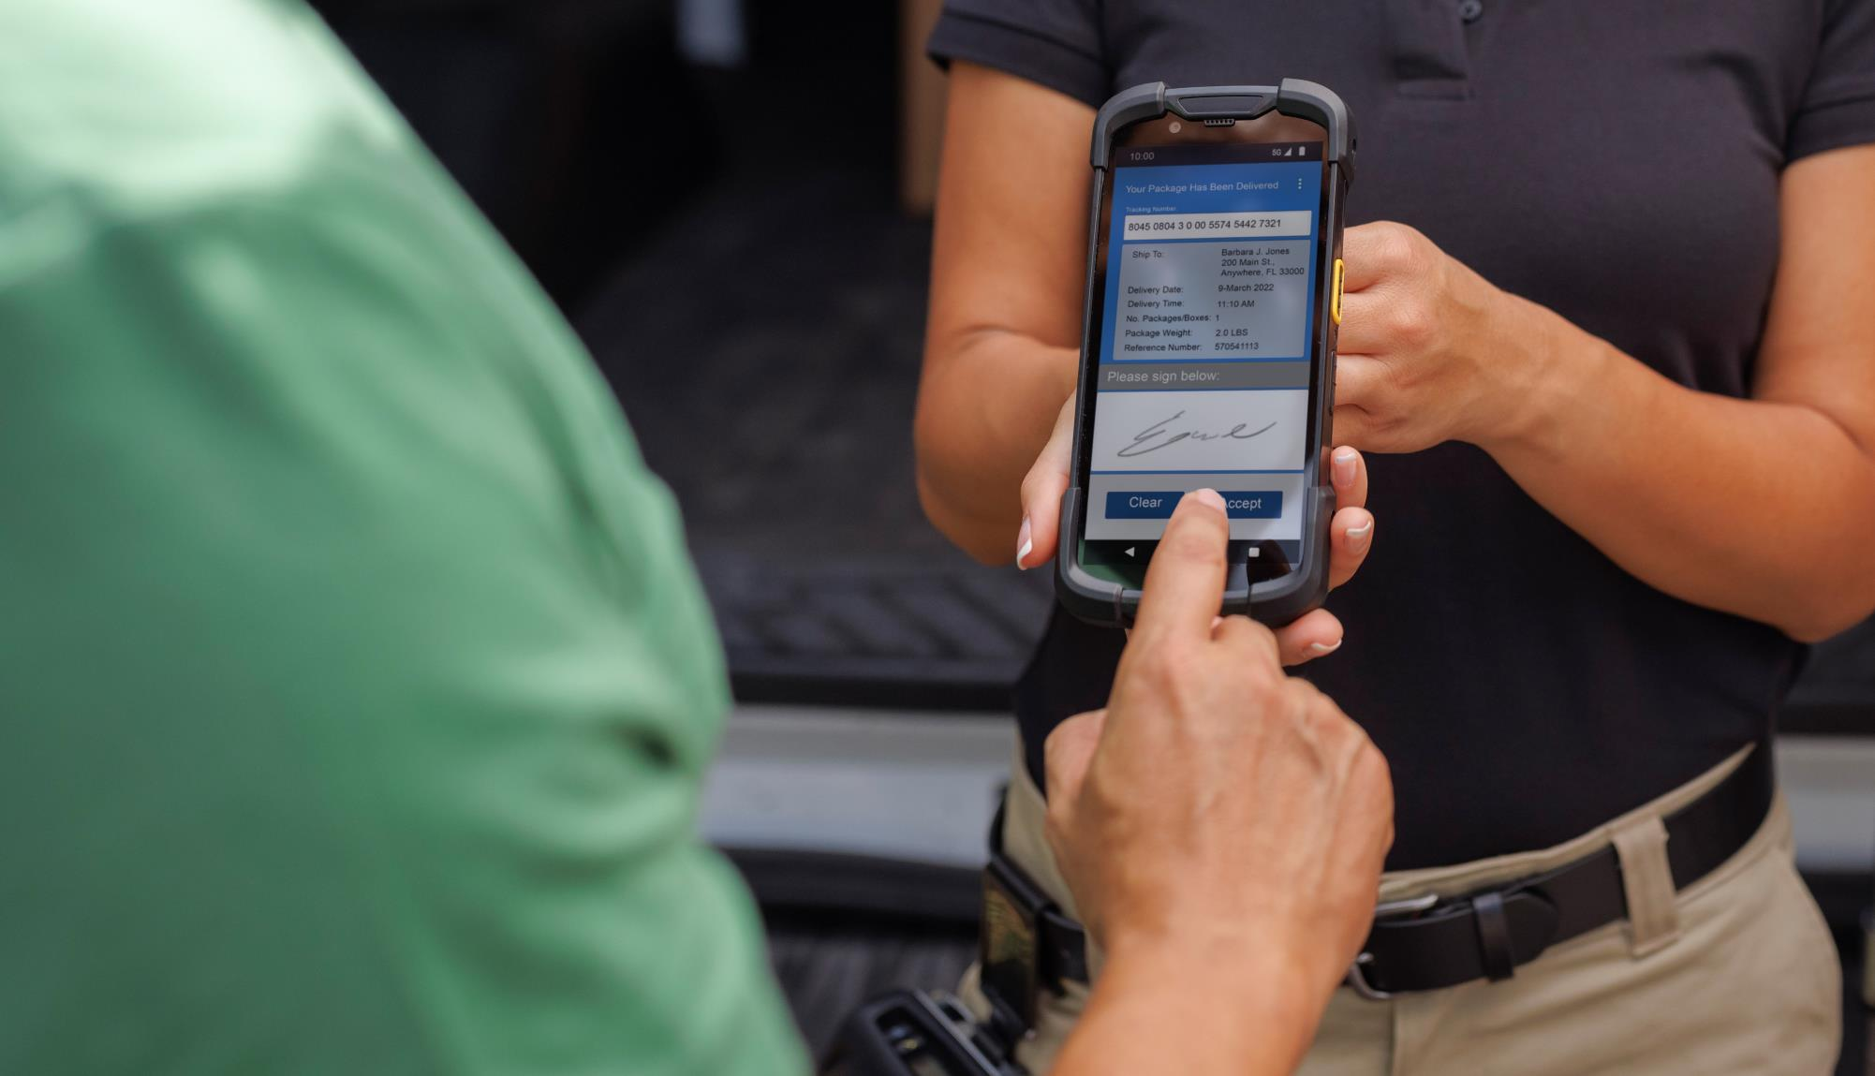
Why Zebra

Slide 4










Why Zebra
Extensive Reach
Scalable to meet any
enterprise demands
Leader Status
Gartner Magic Quadrant for Indoor Location Services — Worldwide
Our People
Make the Difference
Channel
Accolades
$5.6B
Global Sales
#1
128 offices
in 55 countries
Rugged
Mobile Computing
~6,000 US and INTL
patents issued and pending
Data Capture
9,800
employees worldwide
Barcode Printing
10,000+ channel
partners in over 180 countries
Mobile RFID
$567M+ R&D
~10% of Sales
Sources: VDC Research and Zebra analysis (f#1 market share), Gartner, Inc., "Magic Quadrant Indoor Location Services, Global," Tim Zimmerman, Annette Zimmermann, 13 January 2020 (Leader Status Status)
4

Slide 5






Only Zebra offers a deep understanding of software and industry needs
We have committed to Android since 2011
We are the undisputed leader in enterprise Android: 54% market share in 2021, with 36 Android-based products
We have invested more than $300 million in Mobility DNA and refined it through multiple OS versions and thousands of deployments
We added important enterprise security, device management, application management and data capture features
No other vendor offers such a comprehensive ecosystem of software
to support rugged Android devices in the enterprise
5

Slide 6
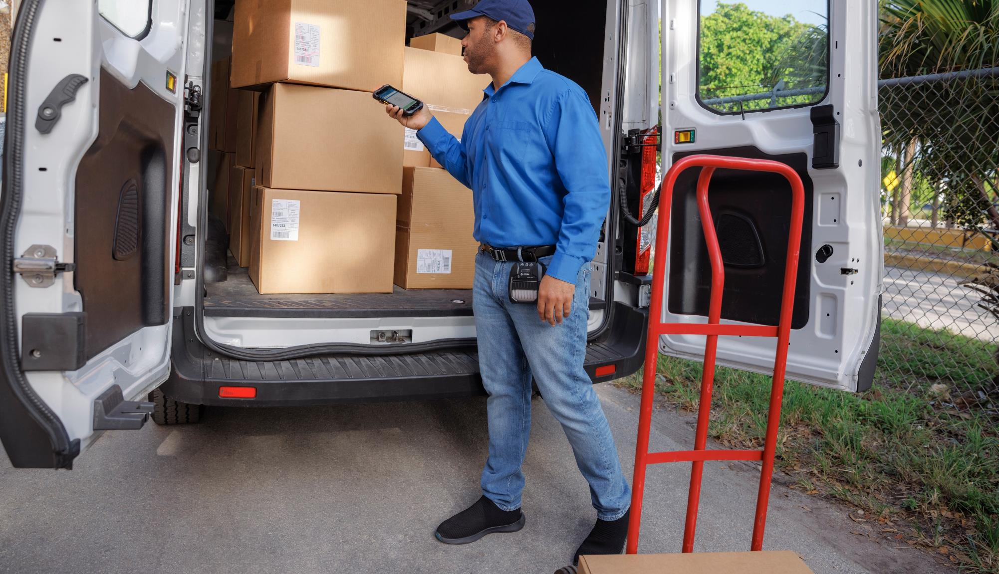
Challenge and Solution

Slide 7



The world is changing, faster than ever before…
The on-demand economy is impacting everything
Customer expectations are growing exponentially
Globalization is reshaping markets and driving competition
Labor and supply chain costs are skyrocketing
The speed and accuracy of workflows have never been
more important
You need a mobility solution that can empower your workers to accomplish more in any environment
You need a solution that can adapt to changing conditions – so you can step confidently into the future

Slide 8


Step into the
new world of
mobility…
A new generation
of mobile computers designed for a
new generation of mobile solutions.
Cutting-edge technology enables new, more effective workflows so you’ll be ready for whatever comes next.

Slide 9
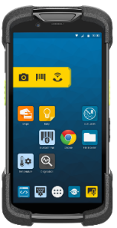
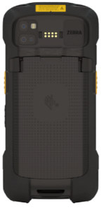
  What sets the TC73/TC78 apart from the rest?
A new significantly faster Qualcomm processor
More rugged with a higher drop spec –
10 ft./3.05 m to concrete
A bigger, brighter
6-inch FHD+
display
5G, Wi-Fi 6E, CBRS* — faster, future-ready connectivity
Enhanced ergonomics
— lighter, thin
and easy to hold
all shift long
Longer product lifecycle: 5 years of availability, 10 years of support
Innovative expandable solutions — from workstation to mobile dimensioning
Industry best data capture including advanced range scanning
Unmatched battery technology including hot swap
Powerful Zebra-only Mobility
DNA tools
* U.S. only

Slide 10








Powering a new generation
of data collection
Optimize inventory and asset management with lightning-fast RFID capture and advanced range imaging
Calculate accurate parcel dimensions
and shipping charges in seconds
Boost team collaboration and customer service with two-way radio, PBX handset and video calling
s
Drive faster BOPIS fulfillment with ARCore indoor locationing applications
Instantly create a full-featured workstation
Run an increased number of demanding applications at once
Be ready for the future of mobile payment and augmented reality solutions
10

Slide 11

Vertical Markets
and Applications

Slide 12
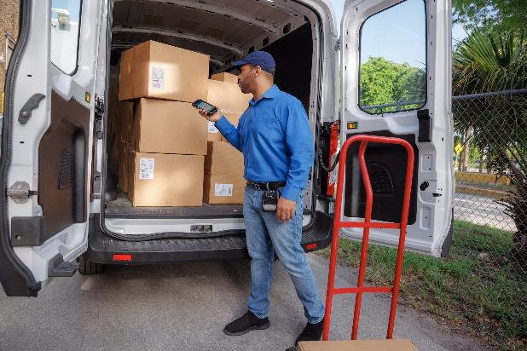
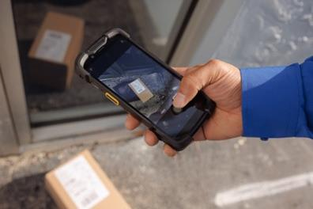
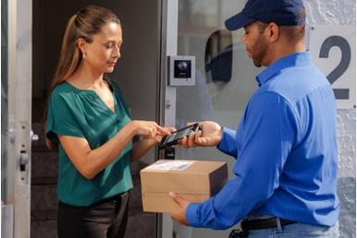
T&L/Postal/Parcel Delivery
Last mile delivery
Package/pallet track and trace
Proof of delivery/pickup (signature/photo)
Route optimization
Fleet management
Payment collection/invoicing
Location Services
Electronic driver logging
Zebra Dimensioning™️ Certified Mobile Parcel
for accurate capture of parcel dimensions and charges at parcel pickup and retail location drop-off
Mobile Parcel for capturing parcel dimensions for planning space requirements at sorting depots, distribution centers and warehouses
In-cab Telematics monitoring
Voice communications
Micro-locationing
12

Slide 13

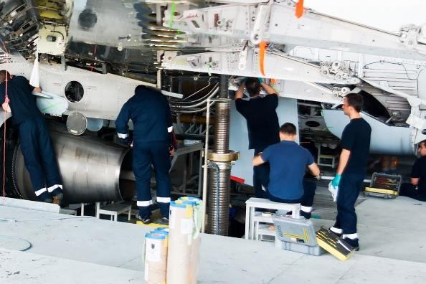

Airlines (under wing)
Baggage reconciliation
Baggage transport
Check-in baggage size verification
Under the Wing crew
Maintenance
Fueling
Freight
Cargo
De-Ice
13

Slide 14
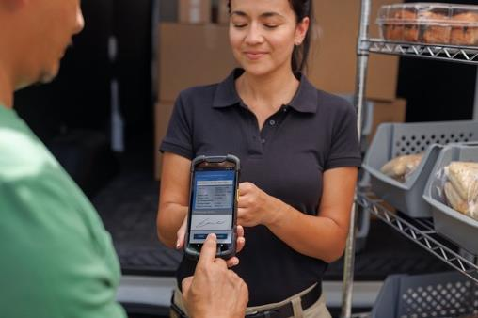

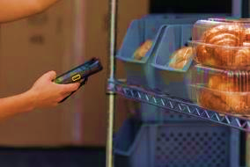
DSD/Route Accounting
Order/returns processing
Delivery tracking
Proof of delivery
Route optimization
Inventory management
Store setup
Planogram compliance
Customer Service
Work order management
Voice communications
14

Slide 15
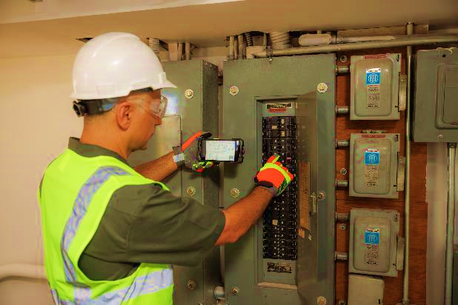
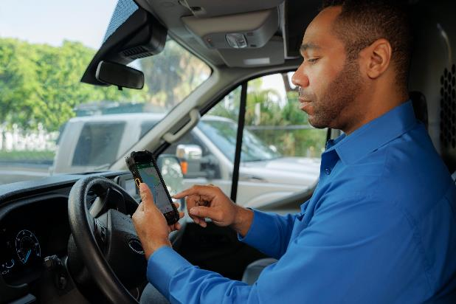

Field Mobility/Field Service
Asset management
Parts inventory
Invoicing
Scheduling and location-based services
Route optimization
Field service training
Mobile Point of Sale
Collaboration
Proximity sensing
15

Slide 16
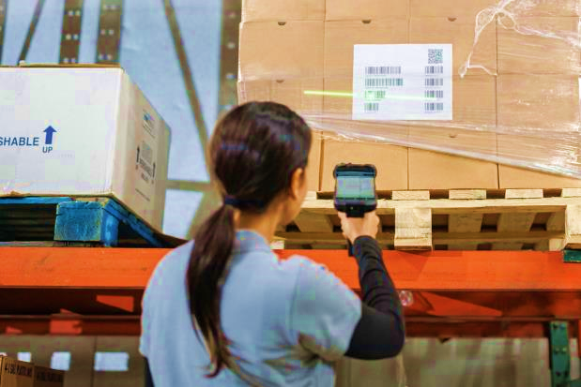

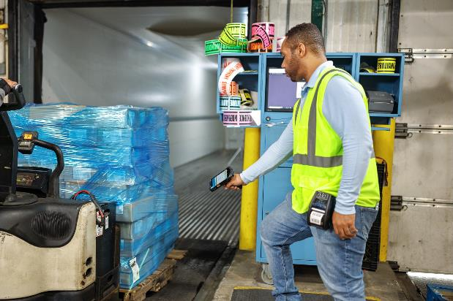
Warehouse
Picking/put-away
Warehouse management
Returns processing
Order/Inventory management
EDI transactions
Voice communications
16

Slide 17

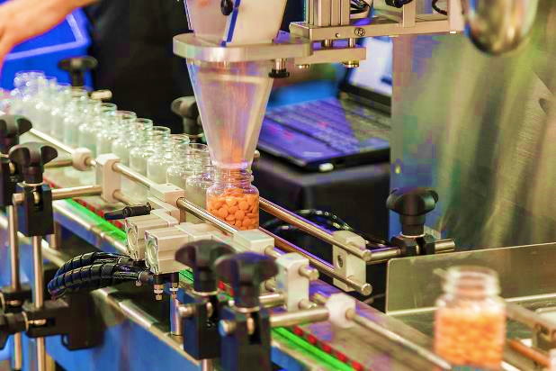

Manufacturing
Asset management
Auto assembly
Assembly line quality control
Track and trace — which worker, completed which task with which part on which car
Product information management
Equipment maintenance
Workforce management
17

Slide 18



Government/Public Service
Citation/ID validation
Situational awareness
Military base access control
Communication and collaboration
Asset management
Warehouse and asset tracking
License plate capture (OCR Wedge)
Vehicle Identification Number (VINs) capture (OCR Wedge)
18

Slide 19


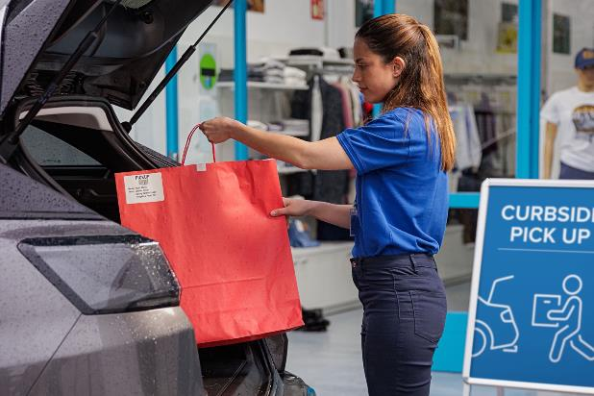
Retail/Distribution Centers
Store shipping/receiving
Price audits/changes
Inventory management
Damaged claim returns
Order replenishment
Voice communications
Zebra Dimensioning
19

Slide 20
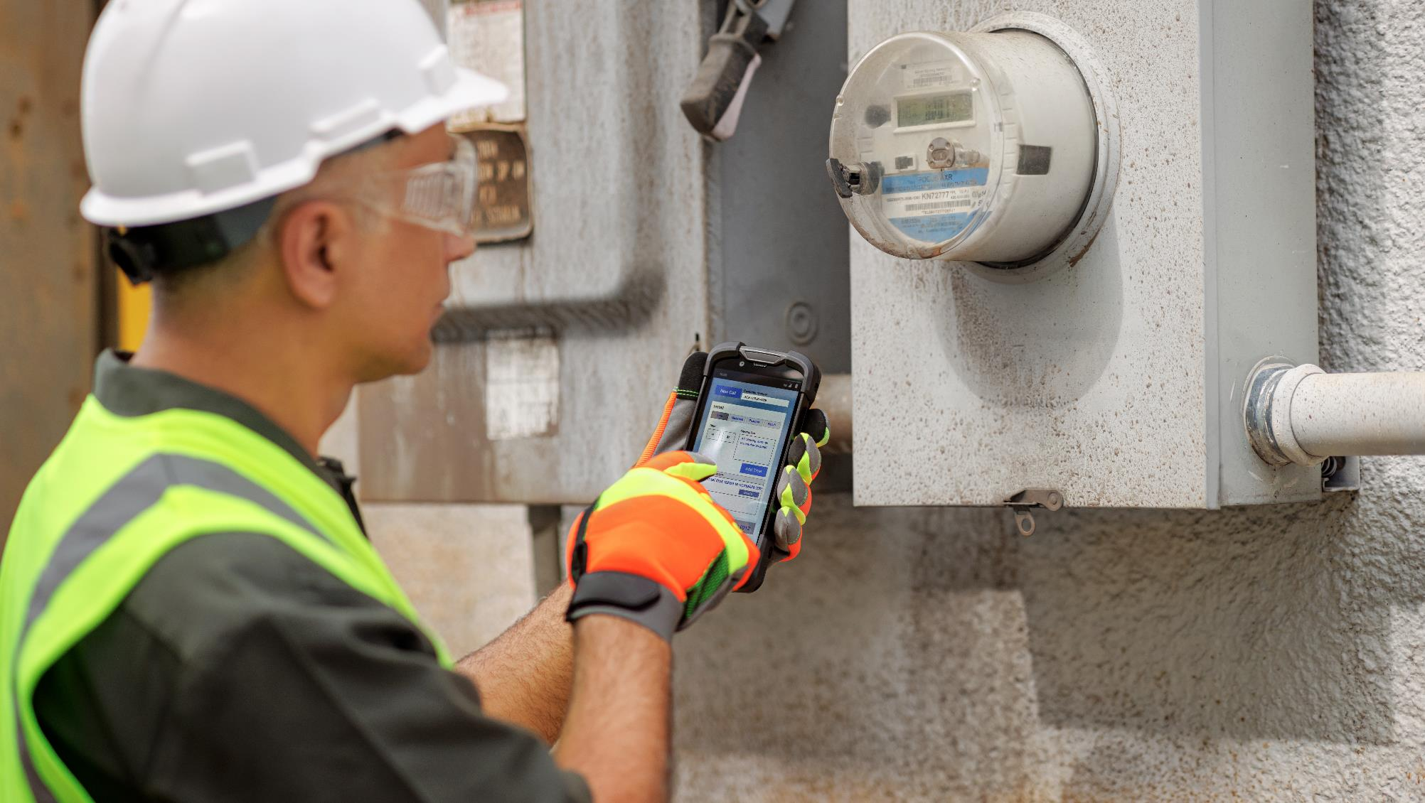
Key Features

Slide 21
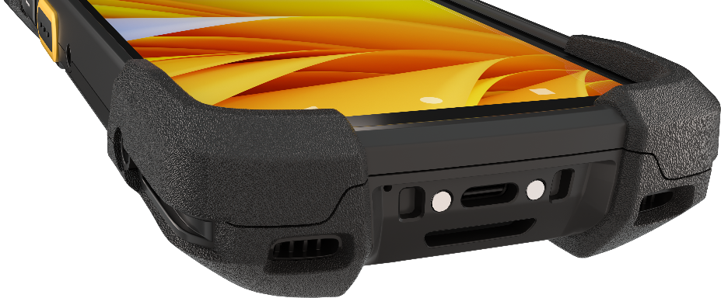
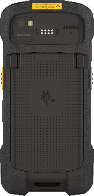
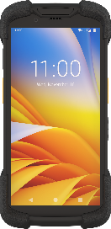
New-generation mobile computing
platform
Leading a new age in mobile computing
First device in its class to offer Qualcomm’s next generation 6490 octa-core processor
Blazing speeds and near instant response times
90% boost in CPU and 400% boost in GPU compared with the SD660 chipset*
Highly accurate locationing
Up to 6 times more accurate compared with the SD660 chipset*, with Z-axis support — ideal for first responders
Future-proof platform
Qualcomm 6490 includes long-term support for future Android releases and supports premium tier features like multi-Gigabit 5G and Wi-Fi 6E connectivity for advanced augmented reality applications
Class-leading memory and storage
Up to 8 GB RAM, 128 GB UFS Flash, plus a 2 TB MicroSD card slot to support your most demanding applications
* Qualcomm benchmark testing

Slide 22
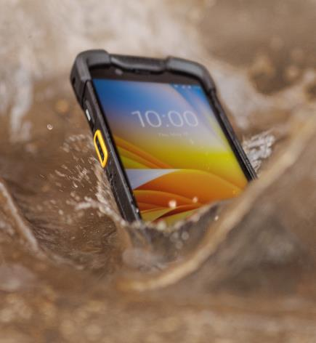
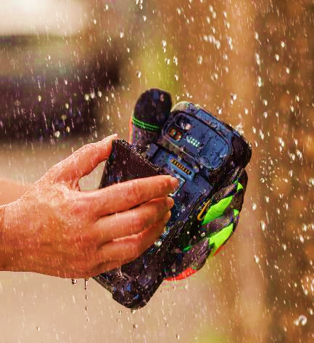
The
most-rugged
device of its kind…
Ultra-rugged to survive your toughest environments
So rugged, you can change the battery in all weather conditions!
Industry-best 10 ft./3.05 m drop spec — without a rugged boot
Survives multiple 10 ft./3.05 m drops to concrete
at room temperature — a 25% increase over the TC72/TC77
Survives multiple 8 ft./2.4 m drops to concrete over the operating temperature range
Tested to latest MIL-STD-810H standard
Survives 2,000 consecutive tumbles
Our punishing tumble test simulates the
real-world tumbling that happens after a fall
Corning® Gorilla® Glass touch panel
and imager window
Provides maximum scratch-resistance and shatter-proofing for the touch panel and scan window
IP68 and IP65 sealing
Dust tight, works when wet and survives accidental drops in water and hose downs
Works in subzero temperatures and searing heat
Operates reliably from…
-4º F to 122º F/-20º C to 50º C
Designed for 5 years of service
Available for sale for 5 years with 10 years of support and service

Slide 23
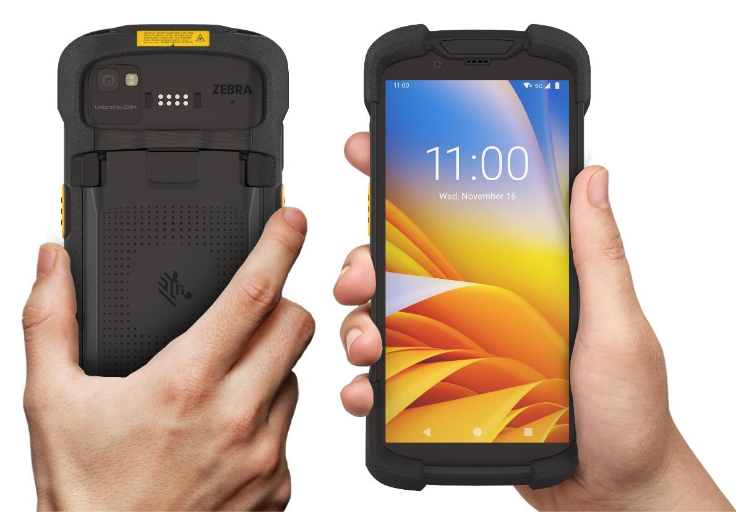
Thinner, Tougher, Lighter
Optimized by Zebra’s award-winning Industrial Design Team
7% lighter than previous TC7X generations – even with the larger display and more rugged drop spec!
Larger, brighter feedback LED provides scan confirmation
in any lighting condition
Increased impact protection with larger one-piece bumper that surrounds device
Well-balanced top to bottom helps prevent wrist fatigue
Thinner grip area ensures worker comfort
Larger, well-positioned side keys are easy to actuate the first time, every time — even with gloves
Contoured surface sides and back reduces pressure points — ensures a more secure and comfortable grip for any sized hand
Sculpted lower bumpers let device rest comfortably in the hand

Slide 24






A leading 6-inch display with all the right features
6-inch FHD+ (1080 x 2160) Largest, highest resolution display in its class — 28% larger than the prior generation TC7X Series
Edge-to-edge technology displays more information —
less scrolling needed
Advanced multi-touch technology works when wet across the temperature range — use a stylus, finger or gloves
Corning Gorilla Glass for maximum scratch-and-impact resistance; optically bonded
Easy to read indoor or outside:
  Bright 600 NITS

Slide 25




Advanced wireless technology
keeps workers productive wherever they are…
Citizens Band Radio Service (CBRS)
(U.S. only)
Connect to private LTE networks in large indoor and outdoor facilities; longer range than Wi-Fi and more economical than cellular
5G support for
access to the fastest
cellular speeds
Close out work orders, load database applications and maps faster than ever with the latest cellular technologies
Better accessory performance with Bluetooth 5.2
Up to Bluetooth 5.2 for highest speed and range; extended battery life with BLE; high quality audio with Audio LE; and more flexible configurations
Be ready for the Wi-Fi networks of today and tomorrow with Wi-Fi 6E
Wi-Fi 6E delivers greater bandwidth, more capacity and reduced latency; future proofs your network with the capacity to support augmented reality and more

Slide 26









Everything’s better with Bluetooth 5.2
From audio quality to accessory performance and power savings to new functionality that paves the way for innovative ways to connect people and devices
LE Power Control transmits more information over lower bandwidth with less power — delivering superior audio quality over Bluetooth headphones, while extending battery cycle times
Connect one Bluetooth device to multiple host devices simultaneously — for example, automatically connect to multiple printers
Connect multiple Bluetooth devices to one host — for example, everyone in a meeting can connect to a DVR to listen to a pre-recorded webinar or product demo video, in their own language

Slide 27

Unparalleled Android leadership
For over a decade, Zebra continues to set the pace when it comes
to Android-based technology, innovations and achievements
Here’s what it means for the TC73/TC78…
Superior roadmap
and future-proofing
All TC73/TC78 models are upgradeable to Android 16
Shipping with Android 11
Exclusive LifeGuard™
for Android™
Provides security patches that keep devices secure every day they are in service
No-touch over-the-air updates and you’re in control over when to update
Complete control over GMS services
Easily control which Google Mobile Services (GMS) are available on your devices; increase the security and privacy of your company data
Exclusive Mobility Extensions (Mx)
Provides over a hundred features you can activate to improve the security, data capture support, wireless connectivity and device manageability

Slide 28

LifeGuard™️ for Android™️
All the features you need to keep your TC73/TC78 devices secure
Timely updates
Aggressive security/patch updates for Android for
up to 10 years
Update options
Three flexible ways to update: fully automatic,
full control and manual
Migration support
A full year to migrate
when a new version of Android is released
One simple file
Single file simplicity and smaller files with Dynamic Packaging
Silent updates
Update invisibly in the background with Google
A/B streaming support
Update status
visibility
Reports to easily
manage updates

Slide 29
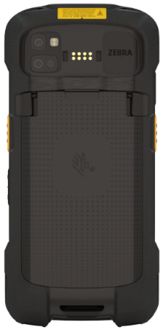
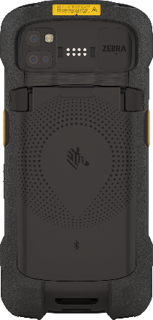
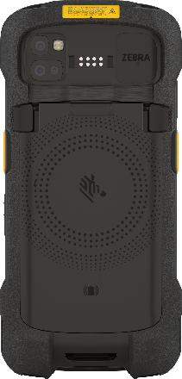
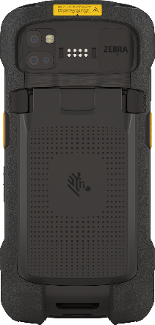
Unmatched battery power — and options
Comprehensive battery lineup lets you choose the battery capacity and features you need
Power Precision+
for real-time battery metrics (All models)
Flexible charging options — use any USB-C charge cable or a Zebra
universal cradle
Fast charging (All models)
Warm swap battery mode
(Standard models)
True hot swap battery mode
(Premium models)
Sealed battery compartment enables anywhere, anytime battery changes
Shared batteries with TC53/TC58 simplify mixed fleet deployments
Standard Battery
(4680 mAh)
BLE Battery
(4680 mAh)
Wireless Charge Battery (4680 mAh)
Extended Capacity Battery (7000 mAh)
More than enough power
for your longest shifts
Find devices even if they
are turned off or the
battery is depleted
Qi compatible wireless charging; available with
TC78 only
Get 1.5x times the power;
power more shifts with fewer
battery changes

Slide 30
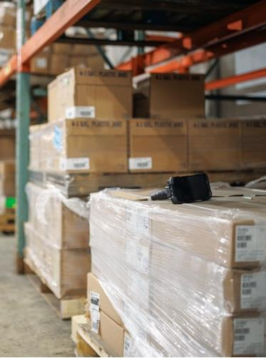
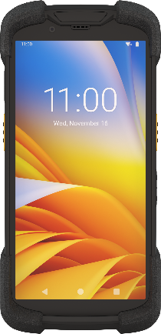
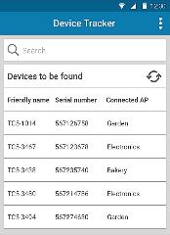
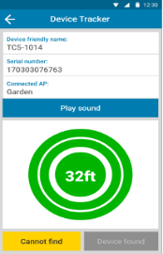
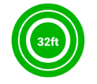
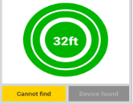
Device Tracker
Track and find your devices —
even if the battery is depleted...
TC7-1014
  Advanced tracking technology
  Optional BLE Beacon battery allows users to easily locate missing devices — even if devices have been turned off or the battery is depleted
  Easy-to-deploy
  Cloud-based service — there’s no infrastructure to purchase and manage
  Grows with your organization
  Supports up to 100,000 devices at up to 5,000 sites
  Improve accountability
  Track who has signed out each device, device status and location
Aisle12
TC7-1014
TC7-3438
TC7-3490
TC7-3494
TC7-1020
TC7-1014
Aisle12
  …maximize device availability, staff productivity and your return on investment
Notes:
t

Slide 31
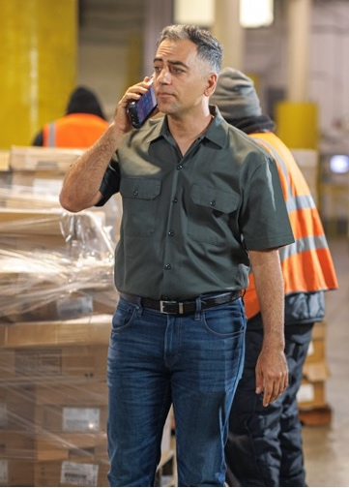
Hear every word on every call
Crystal clear voice on every audio and video
Three integrated microphones
Advanced noise cancelling algorithms
Dual speakers for loudness
High quality speaker phone
HD voice, including Super-wideband (SWB), Wideband (WB) and Fullband (FB) — delivering easy to understand, natural sounding voice — as clear as if you were in the same room
Bluetooth wireless headset support
PTT headset (Zebra USB-C) support
31

Slide 32
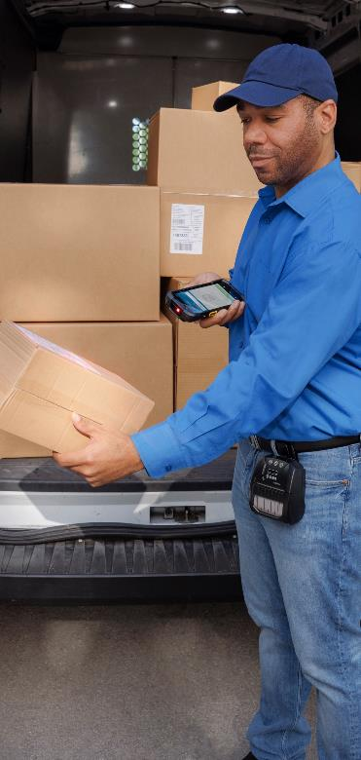
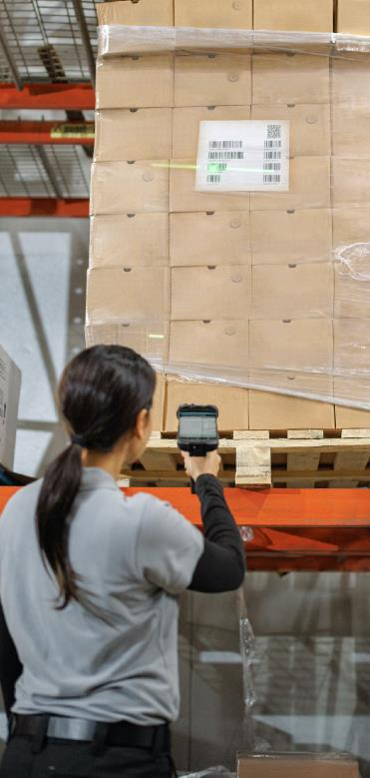
Choose standard or advanced range scanning
Standard range scanning
Advanced range scanning
SE4770 1D/2D scan engine
SE55 1D/2D
Advanced Range
scan engine
with IntelliFocus™ technology
Quickly and easily capture barcodes, labels
and documents
Versatile working range up to
24 in./60 cm away*
Large sweet spot to easily capture large barcodes
Captures barcodes in hand and as far as 40 ft./12.2 m away*
Boost productivity by capturing top-shelf barcodes without a ladder and low barcodes without bending down
Best-in-class green laser aimer is up to seven times more visible than a red laser
* Distance dependent on symbology type and size.

Slide 33
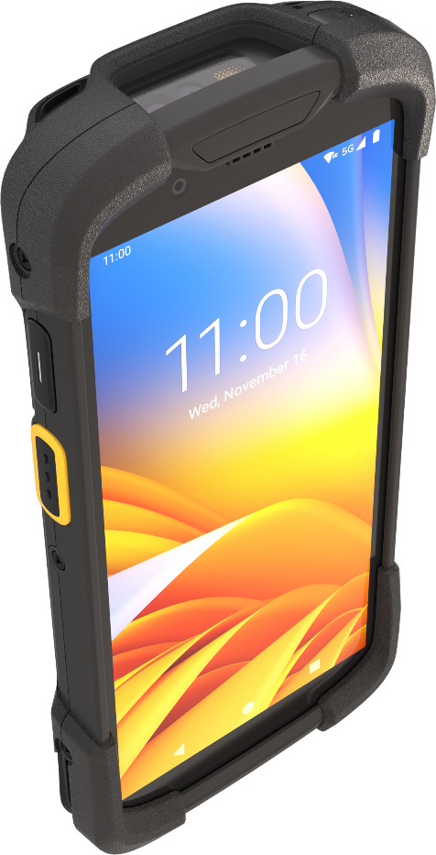
A superior scan experience
Large dual-sided scan keys
Easy to actuate the first time, every time – even with gloves
No matter which scan engine you choose, you can count on Zebra’s industry leading technology and design
Tough barcodes? No problem
With Zebra’s PRZM Intelligent Imaging technology, workers can capture barcodes in virtually any condition
Ergonomic scan keys
Button size and placement enable easy and intuitive scanning; pointing and scanning are in the same plane, delivering extreme comfort by eliminating the need to bend your wrist
Much brighter LEDs
Enables better scanning in low light; instantly know that a scan was successful — in any lighting condition
Long-life trigger
Rated for one million actuations
Automatically capture more kinds of data
With SImulscan NG, you can capture multiple barcodes at once and capture and process information on documents; and with OCR Wedge, you can capture and process strings of text like license plates, container IDs and more
SE4770 scan
engine shown here

Slide 34
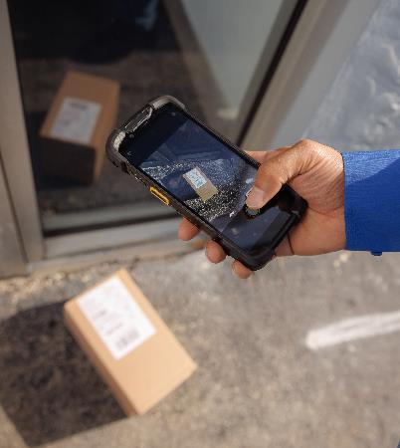
Capture ultra high-resolution photos and video intelligence
The TC73/TC78 makes it even easier to take the high-quality images your business needs — and enables ARCore augmented reality applications
16 MP rear-facing camera
Highest resolution in
its class for superior details
Optical Image Stabilization (OIS)*
Stabilizes the image and video footage; better low light performance
Intuitive enterprise camera app
Includes innovative features like dirty lens detection, a digital level, gesture support
Advanced autofocus technology
Phase Detection Autofocus (PDAF) provides faster and more accurate pictures
High Dynamic Range (HDR)
Captures details even in the lightest and darkest areas of the photo
8 MP front-facing camera
High quality video calls for better collaboration and customer service
* Premium models only

Slide 35

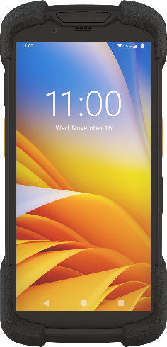




Replace up to five different devices with one TC73/TC78
The benefits of reducing the number of devices in use in your organization:
Reduce your carbon footprint
Simplify life for your users — fewer devices
to carry and manage
Reduce capital and operational costs —
fewer devices to purchase and manage
Deploy new functionality with minimal risk — integration is easy with these Zebra tested
and proven optional solutions
Maximize mobile device functionality —
and your return on investment

Slide 36
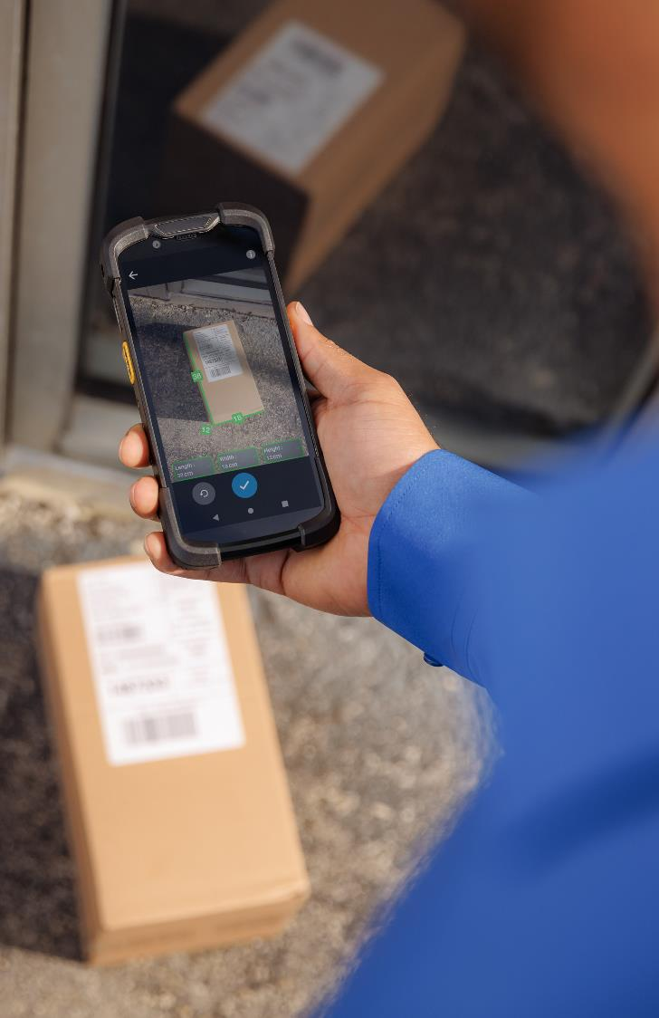





Calculate accurate parcel dimensions and shipping charges in seconds
Industry-first solution Zebra Dimensioning™ Certified Mobile Parcel
Integrated Time of Flight (ToF) depth sensor collects accurate ‘legal for trade’ parcel dimensions in just seconds, with the simple press of a button
Pricing is accurate and workers are more productive — no need to
manually measure boxes
Integrated one-piece solution — no snap-ons
Wide use case coverage — parcel pickup and retail shops, depot sorting;
works with varied box sizes and types, lighting conditions and backgrounds
Non-certified software on Premium SKUs where legal for trade pricing
is not required (warehouse, depot sorting)
* Certified Mobile Parcel requires Certified models; Non-certified Mobile Parcel supported on Premium models.
36

Slide 37
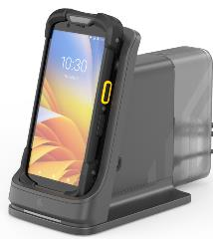



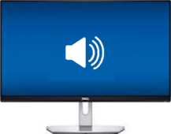







Create an on-demand mobile-driven workstation
With Workstation Connect software and a Workstation Connect cradle, workers can:
How It Works
Use Cases
Manufacturing plant/warehouse
manager
Access key line of business applications, view inventory analytics and dashboards, assign tasks, and monitor workforce easily on a large screen
Access all the apps on the TC73/TC78 and on the corporate network on a large screen with a “desktop-like” interface
Open multiple apps in multiple windows and re-size windows as needed
Continue to use all the apps on the TC73/TC78 while cradled — including PTT Pro or PTT Express
Workstation Cradle
HDMI Monitor
T&L fleet managers
Access the many apps required to manage the fleet on a large screen in the office and on the TC73/TC78 out in the yard
…and your business will:
greatly reduce the need to purchase and manage separate workstations — simplifying your infrastructure and lowering energy use and capital costs
Keyboard
Public Safety
Creates a fully functional
in-vehicle workstation for easy data entry and interaction with databases
for first responders and
public safety officers
3.5mm Headset
Mouse

Slide 38
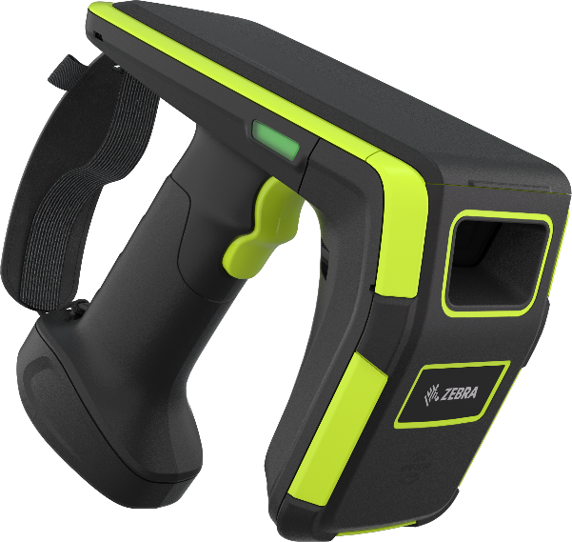
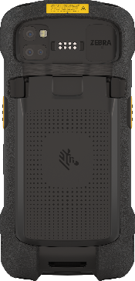
Lightning-fast cycle counting with RAIN RFID powerhouses
Fast — Industry-best 1300+ tag reads per second
Optimized read range — Extended range RFD90 Ultra-rugged
UHF RFID sled
Ultra-accurate item finder mode
Three ways to connect — Bluetooth, NFC or Zebra’s eConnex™ adapter
Integrated 7,000 mAh battery for full-shift run time — and accessible
for quick release without removing the mobile computer
Customizable tri-function trigger lets workers quickly access
often-used features
Wi-Fi 6 enables easy over-the-air management of the mobile computers
and their attached sleds
Ultra-rugged: dust-proof, spray-proof, water-proof and tested for drops up
to 6 ft./1.8 m onto concrete
Superior ergonomics reduce worker strain
eConnex™ technology allows for snap-and-go pairing
38

Slide 39
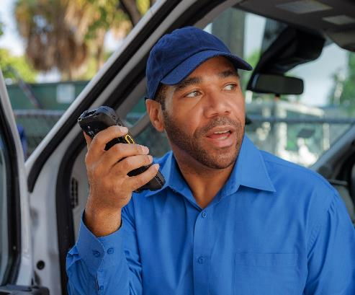
The most powerful family
of ready-to-use optional
Push-to-Talk and voice solutions
Workforce Connect
Push-to-Talk Express
Enable walkie-talkie style communications over Wi-Fi
Easy to deploy — no server
or PBX integration required
Group calls with group/
private response
Support up to 32 talk groups
Connect everyone with any PTT Express-enabled Zebra mobile device
Workforce Connect
Push-to-Talk Pro
Low-cost subscription to enable instant PTT over Wi-Fi and cellular
1-to-1 and group calls
See user presence: available, busy, offline and more
Integrate your two-way radios
Secure text messaging: 1-1 and group
Web-based easy-to-use
management portal
Improve collaboration with
advanced PTT features
Workforce Connect Voice
Fully-featured and customizable mobile PBX handset functionality
Enables workers to answer incoming PBX calls right on the TC73/TC78
Route calls to the right person no matter where they are
Custom interface makes it easy to execute complex features

Slide 40
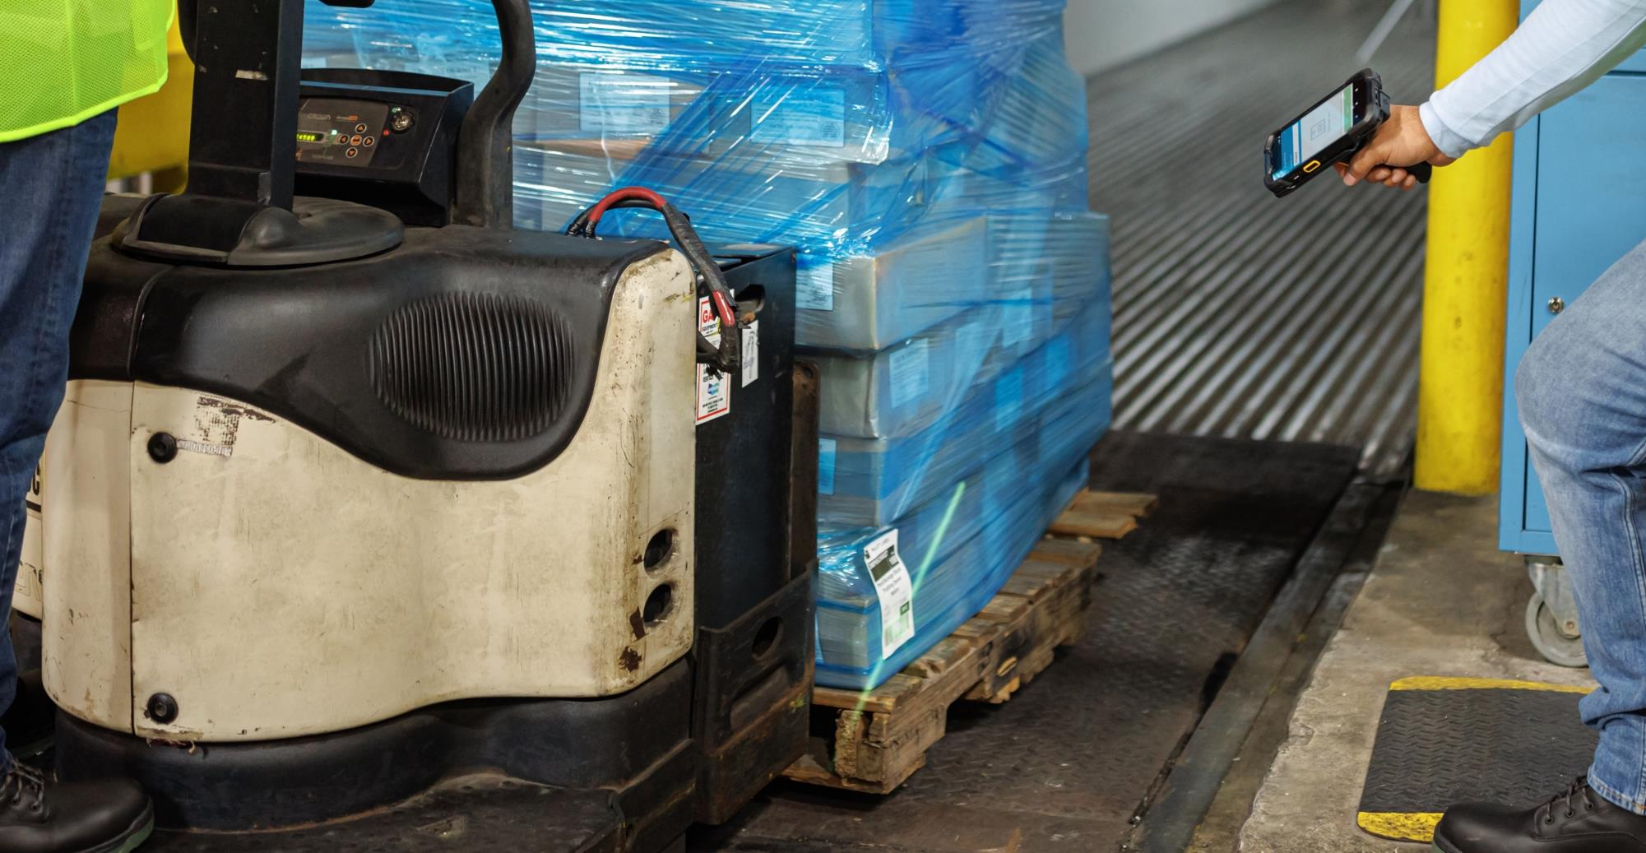
TC73/TC78 Accessories

Slide 41
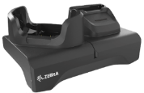
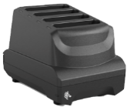




Enterprise-class accessories for every job
2-slot ShareCradle
Charges one
mobile computer
and one spare
battery simultaneously;
charge only and Ethernet models
4-slot battery charger
Charges up to four
spare batteries; standalone or mounted on Mounting Bracket
5-slot ShareCradle
Charges 5
devices; Ethernet
or charge-only
Vehicle cradles
Wireless vehicle charging cradle, vehicle holder
(non-charging)
Snap-on trigger handle
Electrical trigger for rapid fire scanning and added comfort for scan-intensive applications
Unmatched Battery Options
Standard 4680 mAh
Extended Capacity 7000 mAh
Wireless Charge 4680 mAh
BLE Battery 4680 mAh
Additional Accessories
Soft holster
USB cables
Adapter cups
for backward compatibility with TC7x ShareCradles
Fiber tipped stylus
Stainless steel and brass; fiber tip for smooth gliding; works
in snow and rain
Headsets and audio accessories
Rugged wired and Bluetooth HD headsets; USB Audio
Did you know?
Your existing TC72/TC77 ShareCradles will support your TC73/TC78 with just the change of a cup.

Slide 42

Zebra Mobility DNA

Slide 43

When you invest in a mobile device, you
need more than just great hardware — you need great software. And Zebra’s Mobility DNA delivers.
Mobility DNA offers secure solutions to help deploy, manage and support every stage of your devices’ lifecycle. Simplifying device lifecycle management and the user experience, Mobility DNA helps achieve and accelerate greater business outcomes, lowering total cost of ownership, helping to meet your unique business needs.
Mobility DNA
Your mobile computer’s
built-in advantage
43

Slide 44






Zebra Mobility DNA
CIO, Developer Manager
(IT, ISV, SW vendor)
Your mobile computer’s built-in advantage
Effortlessly integrate line of business applications to enhance the mobile user’s experience
Write it once; run it on multiple platforms
Add advanced enterprise features
Leverage Zebra APIs and sample code
Frontline Workers, Operations Manager, Site Supervisor, Associate Manager
Increase the output of your workforce, driving greater job performance
Ensure reliable and consistent connectivity
Reduce disruptions and distractions
Increased end-user productivity
Integrate
Security Manager,
Database Admin
Greater device protection against a world of security threats, reducing your risk and extending the lifespan of your device
Get up to 10 years of timely, security updates
Control and schedule device updates to meet your business requirements
Prevent operational disruptions and protect workforce productivity by customizing user views/access on device
Optimize
Mobility
DNA
Secure
DevOps, Network Admin,
Support Technician
Greater visibility and reduced complexity of managing your devices lifecycle, minimizing downtime and lowering your Total Cost of Ownership (TCO)
Centrally manage devices in multiple locations
Features to take advantage of Zebra device capabilities
Resolve software and network issues faster
DevOps, Network Admin
Manage
Rapidly stage devices to earn the benefits of your investment sooner
Automate staging and enrollment
Flexible staging options (scan, NFC, USB, etc.)
Provision devices for different network environments
Deploy
Notes:
With Zebra Mobility DNA, you’re empowered from the start with built-in applications, utilities and tools that maximize your device performance from integration, security and deployment for easier management and optimization.

Slide 45



Zebra Mobility DNA
Your mobile computer’s built-in advantage
Integrate
  DataWedge API
  Easily create custom profiles enabling faster data capture needs across workflows
  Enterprise Mobility Development Tool Kit
  Take full advantage of your device’s capabilities
  Enterprise Browser
  Build feature-rich web applications
Secure
  LifeGuard™️ for Android™️
  Extend OS security support for up to 10 years
  Enterprise Home Screen
  Specify which apps users can access, disable device features and
  automatically launch apps
Deploy
  StageNow
  Stage thousands of devices with a scan of a barcode or a
  tap of an NFC tag
  Zebra Zero-Touch
  Pre-configure the devices you purchase; out of the box, they’ll provision themselves for faster deployment

Slide 46

Zebra Mobility DNA
Your mobile computer’s built-in advantage
Manage
  Device Diagnostics Tool
  Test major systems to eliminate unnecessary repair-depot trips
  Device Tracker
  Easily track and find lost or missing Zebra mobile devices
  Wireless (Analyzer)
  Capture and analyze wireless data and voice to improve connectivity performance
  Wireless (Fusion)
  Ensure a dependable and superior Wi-Fi experience
  RxLogger
  Capture system and application logs to identify problems and avoid sending no-failure-found devices for repair
  GMS Restricted Mode
  Turn off the Google Mobile Services you don’t want
  Mobility Extensions (Mx)
  Add extra layers of features and services crucial to protecting business data and network access
  OEMConfig (Mx)
  Software application providing a unified interface for all Zebra value-added APIs via the customer’s EMM

Slide 47

Zebra Mobility DNA
Your mobile computer’s built-in advantage
Optimize
  Device Central
  Manage Bluetooth accessories
  All-touch Terminal Emulation
  Convert legacy, green screens into an all-touch, modern UX
  Terminal Emulation Lite
  Give users a modern touch interface with either automatic, predictive reformatting or a customized UX
  Enterprise Keyboard
  Enable fast, accurate alphanumeric entry
  NG Simulscan
  Effortlessly capture the right barcodes (up to 100 barcodes at the same time)
  OCR Wedge
  Effortlessly and accurately capture standardized data to streamline workflows and improve productivity
  TekTerm
  Migrate CE windows mobile applications to Android

Slide 48

Zebra Services

Slide 49

Zebra OneCare™ Maintenance Plans
Choose the Plan that Meets Your Business Urgency
You count on your mobile computers in your most demanding environments and applications. Ensure predictable performance, support for critical operations and improved business outcomes while eliminating unbudgeted repair expenses.
Feature | Zebra OneCare Essential Core assurance | Zebra OneCare Select Maximum protection
Live-agent support | Mon–Fri, 8–5 local time | 24/7
Repair turnaround time | 3-day repair turnarounds | ‘Like-new” replacement device ships for next business day delivery
Accidental damage covered
OS software updates
LifeGuard™ for Android™ security updates
Cloud-based visibility into repair, case reports and more with VisibilityIQ OneCare
Spares pool management
Commissioning Service | Option to include Standard or Advanced Commissioning | Standard Commissioning included, option to add Advanced Commissioning
BENEFITS
Enhanced support beyond standard
warranty coverage
Genuine Zebra expertise and parts maximize device uptime – ensure your device is back to Zebra’s manufacturing specifications
Outstanding value – eliminates unexpected repair costs with a planned maintenance plan
Let Zebra handle support,
while you focus on your strategic initiatives
✓
✓
✓
✓
✓
✓
✓
✓
✓

Slide 50




Zebra OneCare™ Enhancements
Flexible enhancements to fit your business needs.
Tailor your plan even further by planning for battery replacements, expediting logistics and shipping
and commissioning devices with the right software and application versions.
  Battery Services
Proactive Battery Replacement Service – The battery
service that does it all — from remote battery health monitoring
to delivery of new replacement batteries
Battery Maintenance - Tests batteries and replaces those that cannot reach a minimum 80% charge during testing
Battery Refresh - Consolidated shipment of replacement batteries at a predetermined time: month 18 for a 3-year plan; months 18 and 36 for a 5-year plan
  Enhanced Shipping Logistics
Expedited Collections Option - pre-paid shipping labels and to schedule carrier pick up using the Zebra RMA portal
Expedited 2-Way Shipping Option - Express shipping of devices into Zebra’s Repair Center and provides Express return shipping of the repaired devices from Zebra’s Service Center back to the Customer
  VisibilityIQ™ Foresight
This business intelligence service transforms device data into actionable insights in a single, cloud- based, color-coded view. Available whether for use with an EMM or without.
Predictive intelligence helps operational staff anticipate recurring events and catch potential problems before they affect the bottom line
Realize increased workforce productivity, operational efficiency and ROI by optimizing device availability and maximizing asset utilization
  Commissioning Services
Standard Commissioning Service provides an “out of box, ready to use” experience with the repaired or replaced device pre-loaded with OS version, customer SW, applications and configurations
Advanced Commissioning addresses more complex operational and configuration requirements over and above what is provided with Standard Commissioning

Slide 51








Proactive Battery Replacement Service
For just pennies a day, Zebra does all the work required to keep
healthy batteries in all of your Zebra mobile computers, all of the time.
FEATURES
BENEFITS
Constant 24x7 monitoring
Proactive constant monitoring of the status of the batteries in your devices.
Better device ROI
Higher device availability for a higher return on investment
Increased productivity
No more battery-related lost workforce productivity
Lower costs
Lower and predictable battery and support costs
Simplicity and quality
One source simplicity
with quality only the manufacturer can provide
Automatic battery shipment
We ship replacements for batteries that are within 30 days of their Remaining Useful Life (RUL) to the right site.
End-to-end battery management and oversight
We manage the entire process for you — from identifying batteries that are nearing unhealthy to delivering new batteries to the right locations.
Authorized Zebra batteries
Get genuine Zebra PowerPrecision/PowerPrecision+ batteries for unmatched performance and battery intelligence in Zebra mobile computers — and a better battery design
At-a-glance dashboard
Access your VisibilityIQ™ cloud-based dashboard anytime and anywhere to view reports that show the status of your batteries

Slide 52
Thank You!
For more information, please visit www.zebra.com/tc73-tc78
ZEBRA and the stylized Zebra head are trademarks of ZIH Corp, registered in many jurisdictions worldwide.
All other trademarks are the property of their respective owners. ©2022 ZIH Corp and/or its affiliates.
All rights reserved.

