Slide 1

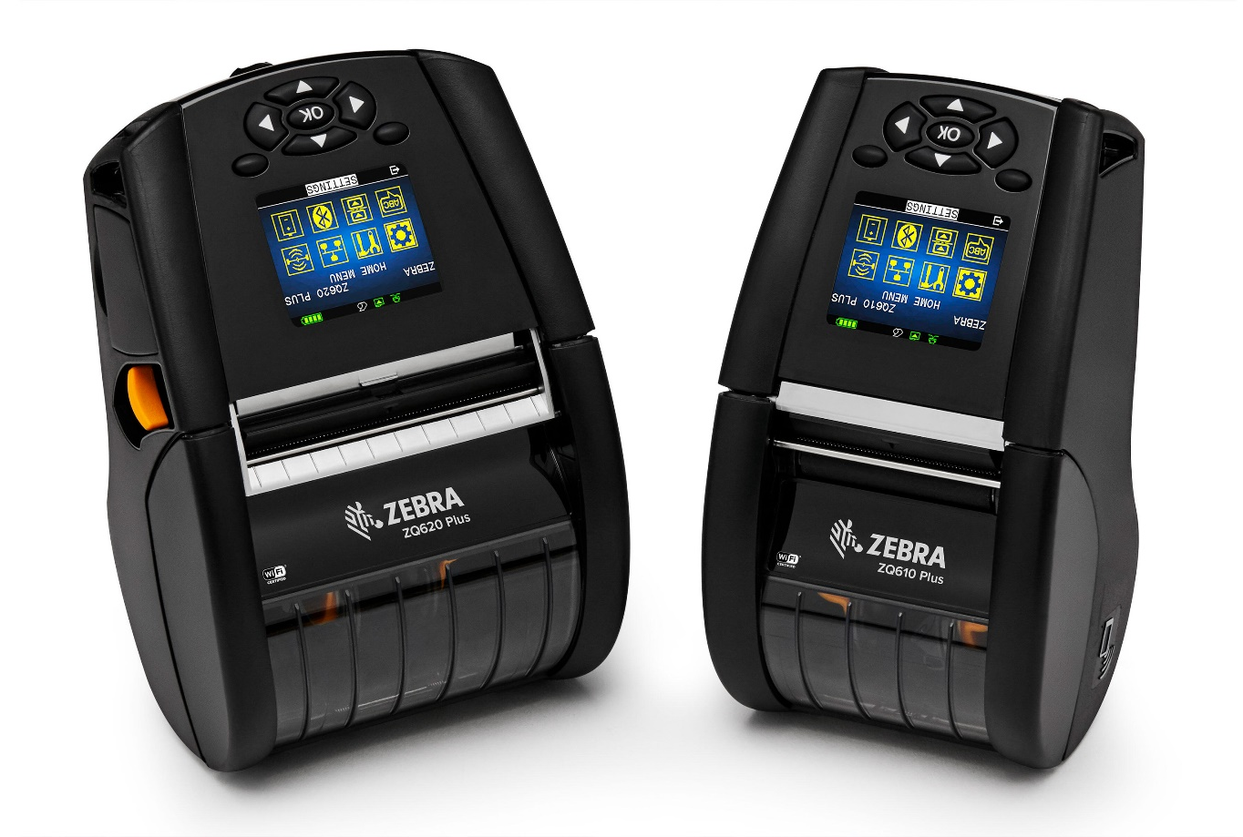
ZQ600 Plus Series
Premium Mobile Label, Receipt and RFID*
Tag Printers
Boost productivity with the
next evolution in mobile printing
*ZQ630 Plus RFID model only

Slide 2
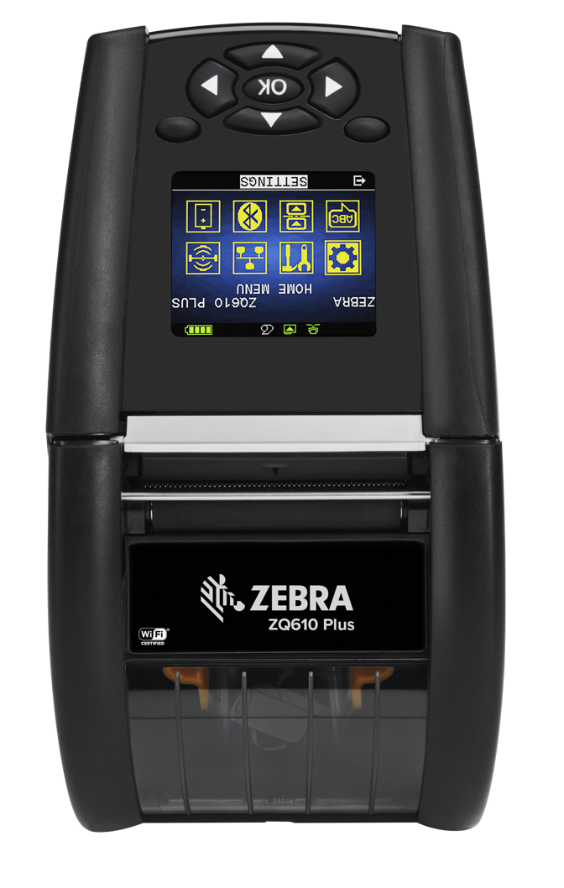
Agenda
  The Business Challenge and Solution
  ZQ600 Plus Series Features and Benefits
  Zebra Print DNA
  Zebra Certified Supplies
  Zebra Global Support Services
  Why Zebra
ZEBRA TECHNOLOGIES

Slide 3
The Business Challenge and Solution

Slide 4





Key Drivers in the Retail Store
Enhance the customer experience
Reduce labor and operating costs
Streamline operations
Improve pricing and inventory management
Keep pace with the competition
While online and mobile commerce have transformed the shopping experience,
91% of all retail sales are still generated in brick-and-mortar stores*
* U.S. Census Bureau; 2017 Retail Vision Study, Zebra Technologies

Slide 5




Key Drivers in Mobile Printing
Meet rising
customer and
partner expectations
Minimize bottlenecks and optimize visibility
Increase individual worker productivity
Reduce errors with on-the-spot printing
Outpace the competition

Slide 6

Key Drivers in the Warehouse
Meet rising
customer and
partner expectations
Manage higher volumes with limited labor
Increase individual worker productivity
Minimize bottlenecks and optimize visibility
Outpace the competition
Using mobile printers and handheld computers during receiving and put-away processes
can improve processing time by 62% and save up to 30 minutes per day per worker*
* How Mobile Printing Benefits Warehouse Operations, Zebra White Paper

Slide 7

Mobile Printers Present Numerous Challenges
IT spends too much time manually tracking and updating our mobile printers
We don’t have any way of knowing how much charge is left in a battery, forcing us to invest in a large spare battery pool so staff can carry extras
Just a few extra seconds per print job can have a significant impact on our productivity
Users run out of power and waste time swapping or searching for a new charged battery
We don’t have a dedicated support resource at each location and too often, we ship a printer to the depot even when nothing is physically wrong
Printers need to be simple and intuitive to use from day one, especially since we utilize seasonal and temporary workers

Slide 8
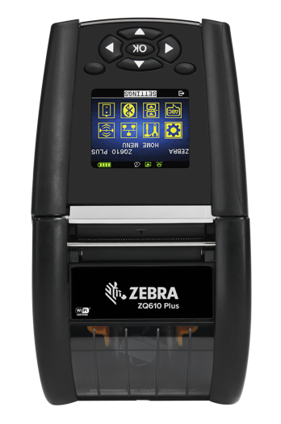
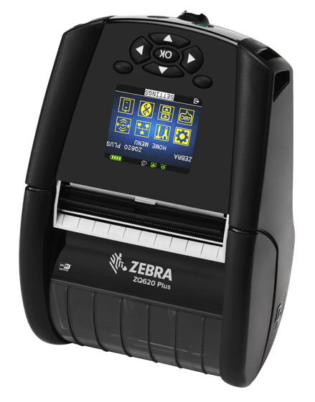
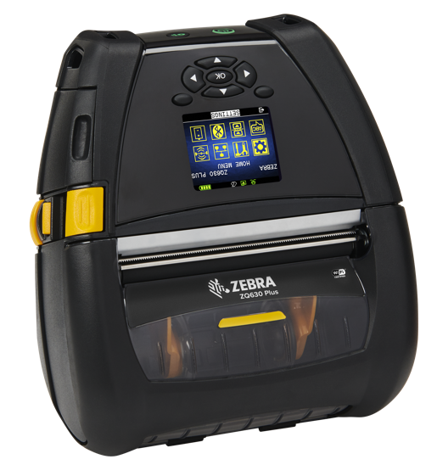
INTRODUCING THE
ZQ600 PLUS SERIES
Premium mobile label, linerless, receipt and RFID* tag printing
Premium features,
including RFID* for
maximum productivity
Faster, easier, highly reliable wireless connections
Full-shift battery power
and best-in-class
power management
Linerless media support generates less waste
Comprehensive remote management options for maximum uptime
An advanced platform that grows with your business
*ZQ630 Plus RFID model only

Slide 9
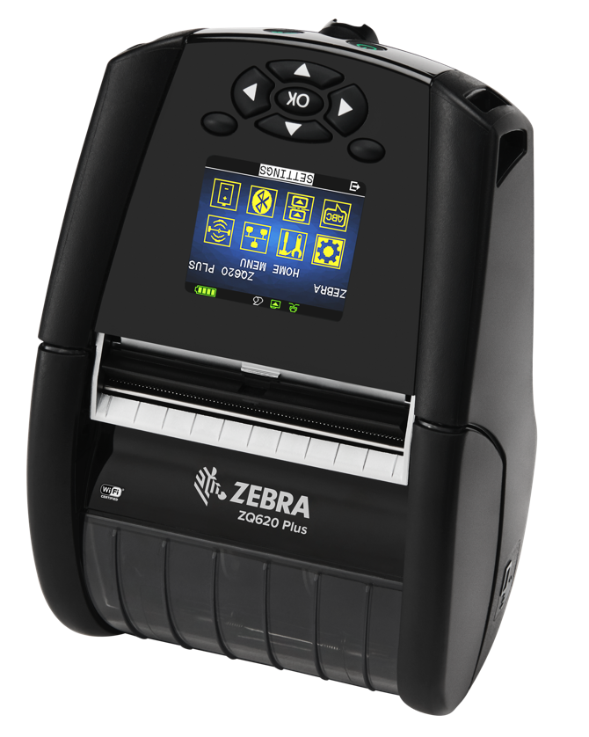
New All Over Again
We took the highly successful QLn Series and made it better
A proven platform
With over a million QLn printers sold to date, you get a well-proven platform, with all the latest mobile
printing features
Backwards compatibility
With QLn accessories
Re-use existing QLn accessories with the ZQ600 Plus Series printers—no need to purchase new accessories or rebuild your settlement room
+
=
Cost-effective, no-risk upgrade
to the latest technologies
ZEBRA TECHNOLOGIES

Slide 10



ZQ600 Plus Series Applications
Receipt, label, linerless and RFID* tag printing
Retail
Shelf edge labels
Mark down labels
Replacement tags
Mobile point of sale receipts
Return and transfer labels
Buy Online Pickup in Store (BOPIS)
Merchandising
Manufacturing / Warehousing
Pick and pack labels/lists
Raw materials
Finished goods
RFID case / Pallet labels*
Transportation & Logistics
Receiving
Put Away
Reverse logistics
inventory management
Cycle count
Cross-docking
Picking
Staging
Packing
Shipping
*ZQ630 Plus RFID model only

Slide 11
Features and Benefits

Slide 12
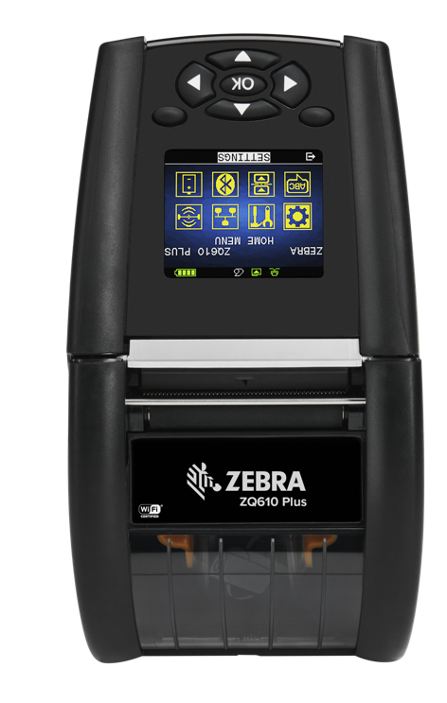
ZQ600 Plus Series Highlights
New features that are not included in the QLn are denoted in blue
Color display makes configuration
and operation a snap
Industry's first Wi-Fi 6 (802.11ax)/Bluetooth® 5.3 mobile printer for faster, more reliable and more secure printing
(802.11ac / BT 4.2 configuration also available)
Robust memory to support upgrades and new applications for years to come
High capacity PowerPrecision+
3250 to 6600 mAh battery
Power Smart Print Technology™
reduces power consumption up to 30%
Optional ZQ610/ZQ620 Plus Extended Battery Pack (6500 mAh)
Prints labels, receipts and linerless
Intelligent sleep mode with instant wake-up over Wi-Fi™ and Bluetooth
Easily manage from anywhere with flexible remote management options
802.11r fast roaming for seamless on-the-move dependable Wi-Fi connectivity
Print and encode RFID* tags
2-in., 3-in. and 4-in. models
Long-lasting durability: tempered glass and high-grade resin
Maximum productivity, ease of use and manageability
ZEBRA TECHNOLOGIES
12
*ZQ630 Plus RFID model only

Slide 13
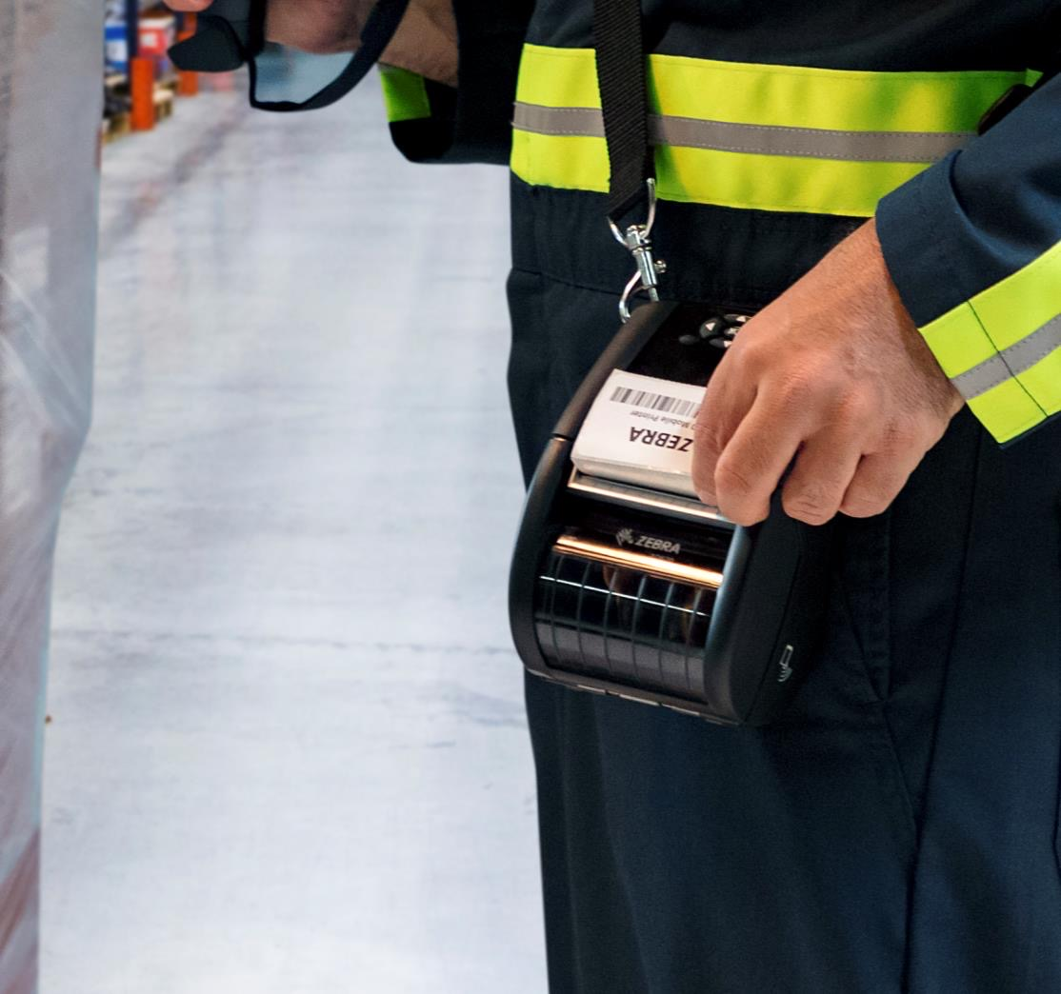
Compact and Tough
Built for all-day, everyday use
The ZQ600 Plus is loaded with features that give it long-lasting durability, including…
High-grade resin, one of the toughest plastics available
Tempered glass display
Seamless one-piece design
Numerous mechanical design improvements for greater impact resistance and durability
ZEBRA TECHNOLOGIES

Slide 14
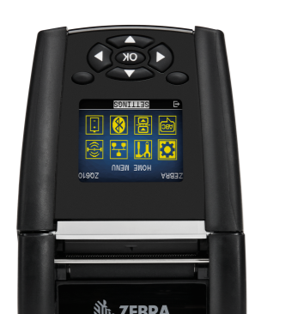
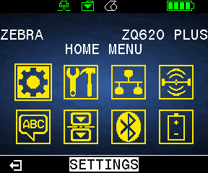
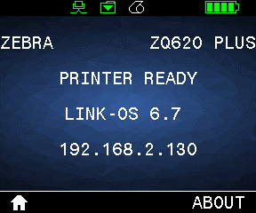
Large Color Display
Makes it easy to set up and maintain the ZQ600 Plus Series
User-friendly interface: easily customized menu and five-way navigation with two soft keys
Display changes colors to show an alert so users instantly know what the printer needs to stay up and running
ZEBRA TECHNOLOGIES
14
14

Slide 15
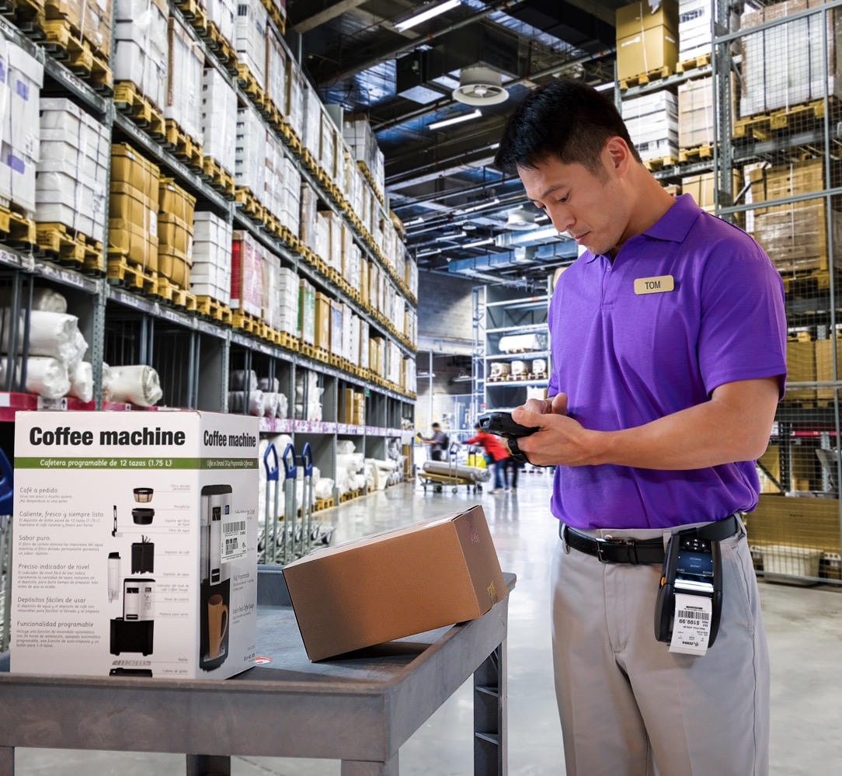
Faster, Easier and Highly
Reliable Wireless Connections
With Zebra, you can count on the latest wireless
technology and industry-best performance
Wi-Fi 6 (802.11ax) and the latest Wi-Fi Security Protocols
Industry-standard 802.11r
Fast Roaming
Fast and secure printing on a Wi-Fi network
(802.11ac/BT 4.2 dual radio configuration
also available)
Ensure seamless access for workers as they move throughout the store,
hospital or other facility
Bluetooth 5.3 Classic and Low Energy*
Faster connections and wider range
ZEBRA TECHNOLOGIES
*Bluetooth 5.3 available on 802.11ax / BT 5.3 dual radio option. Bluetooth 4.2 is available on Bluetooth-only option and 802.11ac / BT 4.2 dual radio option.

Slide 16





Large Color Display
Benefits with Wi-Fi 6 Mobile Printing
ZQ600 Plus Series with 802.11ax + Bluetooth 5.3 Dual Radio
Boost productivity even more with the first Wi-Fi 6 mobile printer on the market
Key Benefits
Zebra Quality You Can Count On
Protect sensitive data with best-in-class, WPA3 security
An industry leader driving innovation with the first Wi-Fi 6 mobile printers
Print anytime, anywhere with improved roaming capabilities
Backed by reliability and long-lasting durability
Connect faster and more reliably with higher throughput and lower latency
Connect more devices with higher
client density

Slide 17


Protect Productivity
With instant wake-up over Wi-Fi
Forget about frustrating printer reboot times that drain productivity
The ZQ600 Plus Series will be ready whenever workers press print
HOW DOES IT WORK?
The printer enters sleep mode to conserve the battery when it hasn’t been used for a pre-configured amount of time
The moment a user sends information
to the printer, it automatically wakes up and begins printing
It’s seamless and works over both Bluetooth and Wi-Fi

Slide 18
Maximize Uptime
With Comprehensive Remote Management Options
Easy Remote Management With Ethernet Cradle
Print DNA Management Tools– Only From Zebra
Additional Value-add Visibility Service Option
Just dock the printer to:
Remotely update firmware
Remotely diagnose and troubleshoot issues to minimize the incidence of ‘no trouble found’
PPME:
This optional browser-based management tool enables remote management without an MDM
MDM Connectors:
Integrates ZQ600 Plus Series printers into your SOTI MobiControl or AirWatch MDM
Also supports Ivanti Avalanche (powered by Wavelink) out of the box
Deep operational insights:
Operational Visibility Service (OVS) provides a wealth of information, including condition, location, repair status and more
Includes an MDM or works with your existing MDM
18

Slide 19





Superior Battery Technology and Power Management
One of the Highest Capacity
Batteries in Its Class
User-replaceable, high capacity 3250 mAh (ZQ610 Plus/ZQ620 Plus) and 6600 mAh
(ZQ630 Plus/ZQ630 Plus RFID)
Power-Saving Sleep Mode
Conserve battery power; instant wake mode protects productivity
Retail and warehouse workers depend on their mobile printers to deliver a superior customer experience. Make sure each worker has more than enough power for every shift
Power Smart Print Technology™
Patented technology reduces power consumption by up to 30%
Better Battery Management
Wealth of real-time metrics to easily identify aging batteries before they impact productivity

Slide 20
Proactively Manage Both the Printhead and Battery
Only Zebra gives you the ability to proactively manage these two critical elements of a mobile printer
Ensures continued reliability and performance of your ZQ600 Plus Series printers
Printhead Diagnostics
PowerPrecision+ Battery Management
Get visibility into the health of printheads
across your deployment
View diagnostics locally or remotely
Receive alerts when a failure is detected
Wealth of real-time battery metrics, including battery performance and capacity degradation
Make sure batteries in your devices are fully charged at the beginning of every shift—and always healthy enough to hold a full charge
Minimizes the number of spare batteries required

Slide 21



Go Green with Linerless Media
No place to dispose of liner trash? No problem
50% immediate waste reduction via reduced roll volume
Up to 60% more labels per roll—requiring fewer roll changes and
work disruption

Slide 22
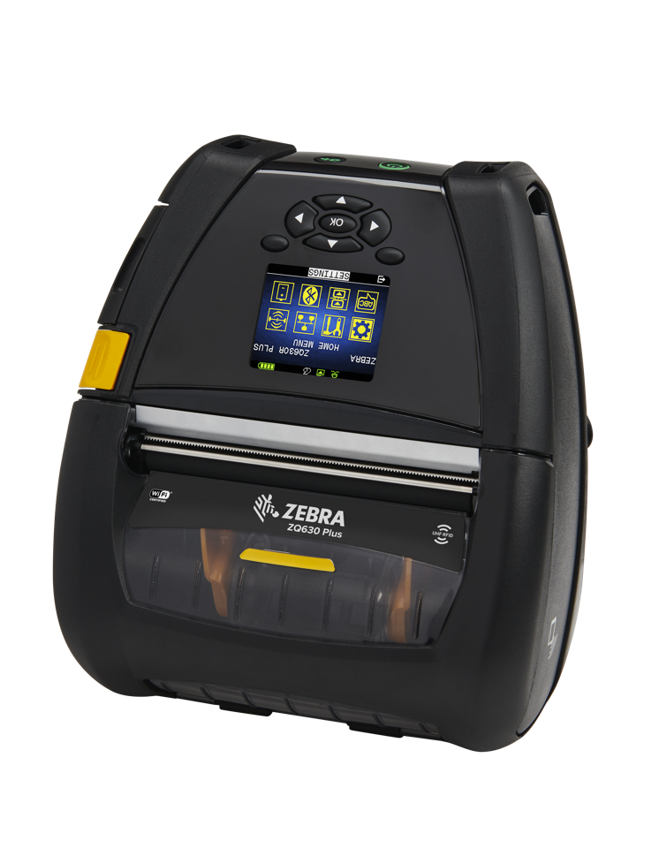

INTRODUCING THE
ZQ600 PLUS RFID
RFID Printing & Encoding,
right in the palm of your hand
The ZQ600 Plus Series is loaded with features, now including RFID technology*, for maximum productivity
Automatic calibration features makes setup simple
Print and encode RFID labels with ease, when
and where needed
Compatible with all current Zebra RFID technology
Calibrate RFID media only once—no need to recalibrate with same-type media changes
*ZQ630 Plus RFID model only

Slide 23
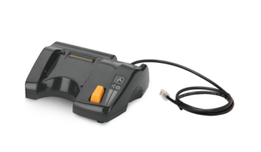
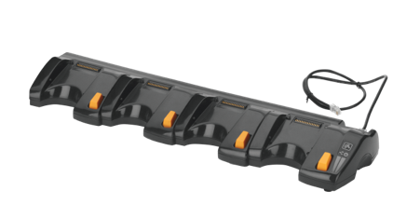
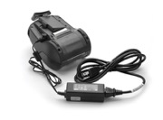
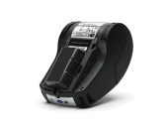
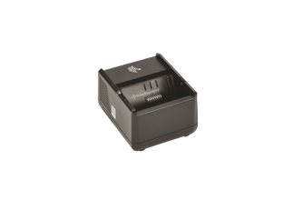
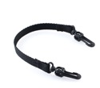
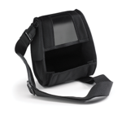
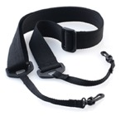
A Full Suite of Accessories for Your Store
Ethernet Cradles
Charge printers and connect them to your wired Ethernet network for easy remote management
Single-Bay
Ethernet Cradle
Quad-Bay Ethernet Cradle
Link and manage up to
4 cradles/16 printers with one port
AC Adapter
Extended Capacity Battery*
Battery Chargers
Charges ZQ600 Plus Series Lithium-Ion batteries
Single Slot Battery Charger
3-Slot Battery Charger
Dual 3-Slot Charger with Y Cable
(charge up to 6 batteries)
Soft Case
Hand and Shoulder Straps
Backward compatible
with QLn accessories
QLn customers can cost-effectively upgrade to the latest platform—
no need to purchase new accessories or rebuild the backroom
*Only available on the ZQ610 Plus & ZQ620 Plus

Slide 24

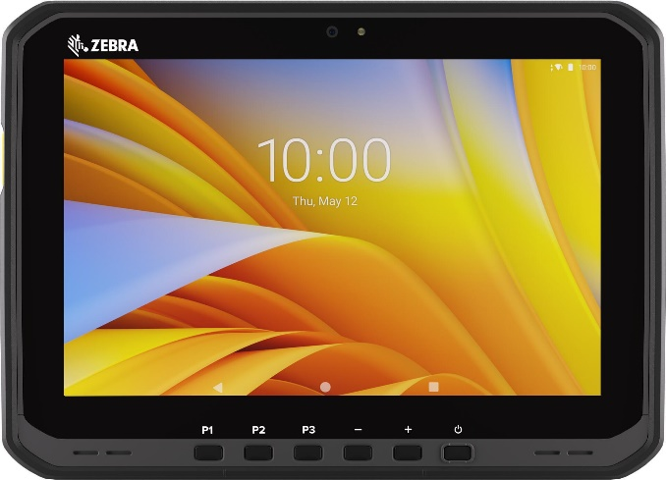
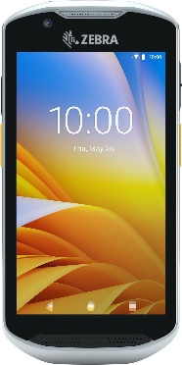
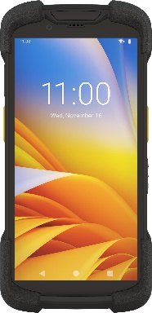
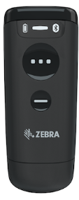
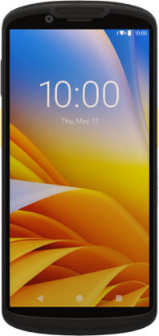
Better Together
Use the ZQ600 Plus Series with Zebra
mobile computers and scanners for
a complete mobility solution
Seamless
interoperability
Leverage your Wi-Fi 6/6E network with printer and mobile computer support for 802.11ax
Barcode Scanners
Mobile Computers
Tablets
DS8100 Series
CS60
TC52ax
TC53
TC73
ET40
ET60
ZEBRA TECHNOLOGIES

Slide 25

Transforming printers from the inside

Slide 26
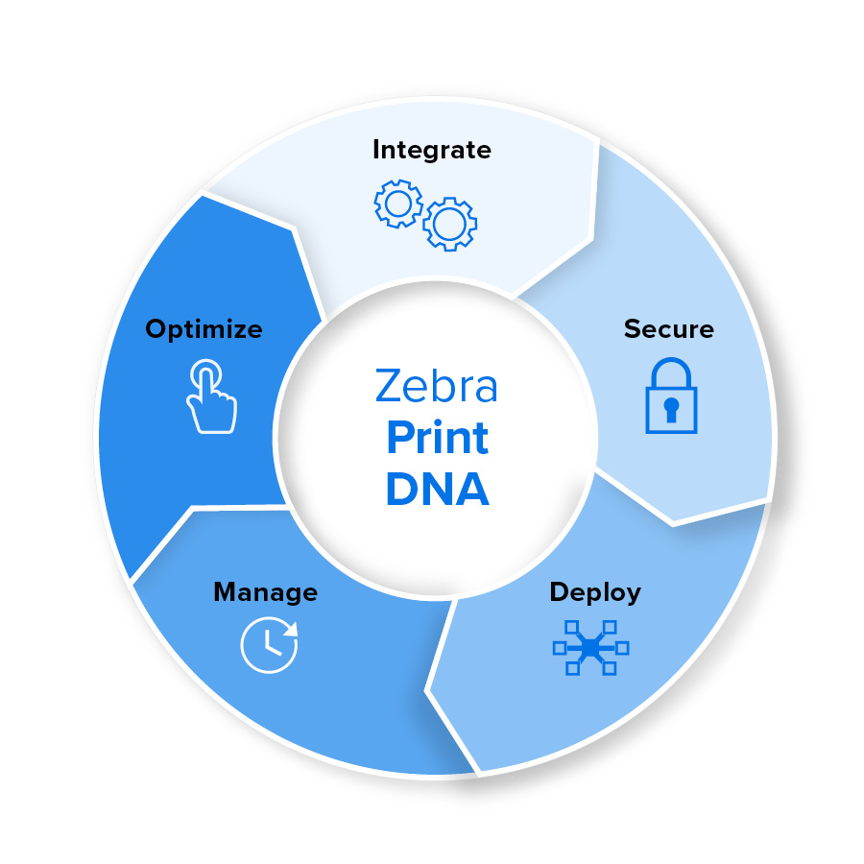
Your printer’s built-in advantage
Zebra Print DNA™
Print DNA is a suite of software capabilities built into Zebra printers that gives you the ability to optimize printer performance over their entire lifecycle even as your business needs change
Optimize
Integrate
Offer everyone super simple, reliable printing that makes their job so much easier to do
Effortlessly customize and integrate print apps for multiple environments and infrastructures
Printer Emulations
Pairing Solutions (Print Touch)
Print Station
Multiplatform SDK $
Network Connect Printer Software $
Browser Print
Manage
Cloud Connect
Print Connect
PDF Direct
Enable IT to conveniently manage and maintain printers anywhere, anytime, alleviating common IT headaches
ZebraDesigner Pro $
Printer Emulations
Print API
Printer Profile Manager Enterprise $
MDM/EMM Connectors $
PowerPrecision
ZebraDesigner
Printer Emulations
Managed Print Services $
PrintSecure (Automated Wi-Fi Cert)
Secure
Deploy
Give IT the ability to uncover potential vulnerabilities and defend against security attacks
Accelerate rollouts with an easy-to-use setup wizard, remote access and streamlined steps
PrintSecure
Printer Setup Utilities
(Security Assessment Wizard)
Printer Setup Utilities
Printer Profile Manager Enterprise $
Pairing Solutions (Print Touch)
Notes:
Based on decades of enterprise experience, we engineered software to overcome the challenges each persona will face at each stage of a device’s lifecycle. The result is a better experience for users and a better outcome for the organization, whether it’s a small business without an IT department or a conglomerate with intricate sets of teams.

Slide 27




Protect Your Business From Damaging Security Threats
With Zebra’s PrintSecure
Not all security measures can measure up to your needs.
Unlike other providers, only Zebra offers the comprehensive printer security you need for peace-of-mind protection. As you consider adopting new technology, consider these critical security attributes:
Built-in Protection and Performance
Highly effective security protocols and features; control onsite and network
access to prevent tampering
Continuous Vigilance and Support
See activities in real time to expose events before they happen and push updates on your schedule–onsite or remotely
Customizable for Your Needs
Compare your printer settings against best practices, adjust security levels based on your company needs
Stop Events Quickly
Rapidly and effectively deactivate vulnerable
printers to prevent further intrusion
Simpler Maintenance and Service
Remotely manage and maintain your entire networked printer fleet to maximize uptime
and reduce the burden on IT
Automated Security Capabilities
A secure connected environment
for you and your team
Aligned With Globally Recognized Standards
Best practices and guidelines set by
the world’s security experts
A Leader in Secure Enterprises Technology
Productivity and security are at the core of
everything Zebra does

Slide 28
Zebra Certified Supplies

Slide 29
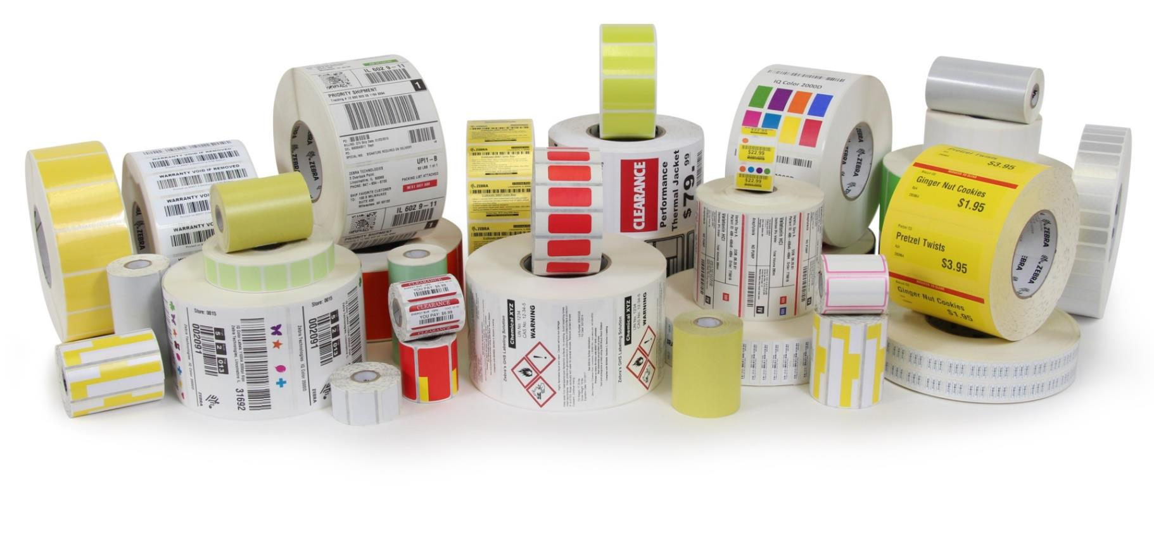
The Benefits of Choosing Zebra Certified Supplies
1.
2.
3.
4.
Printer Uptime
No supply-related downtime
Workforce Productivity
Increased worker and process efficiency
Customer
Service Quality
No delays related to printer supplies
TCO
Reduced capital, operational, maintenance and troubleshooting costs
ZEBRA TECHNOLOGIES

Slide 30



Maximize Visibility with Zebra’s RFID Labeling Solutions
Zebra is the global leader in RFID technologies
Large Offering of
In-stock RFID Labels
Exceptional Performance and Consistency
RFID & Label
Solution Expertise
Realize the benefits of
RFID faster
Streamline proof-of-concept and implementation
No long lead times or large minimum order quantities
Feature the latest chip technology
Enhanced performance with
Zebra-branded inlays
ISO 9001:2015
quality processes
Global leader in
RFID technologies
Understand what impacts application performance
Knowledge to recommend
a solution that delivers
exceptional performance
Experts in thermal
printing materials

Slide 31
Zebra Global Support Services

Slide 32


Support and Visibility Services
Maximize printer uptime, business operations and
your return on investment
ZEBRA TECHNOLOGIES

Slide 33
Zebra OneCare Support Services
You count on your printers to keep your business up and running. Ensure predictable performance, support for critical operations and improved business outcomes, while eliminating unbudgeted repair expenses.
Zebra OneCare™ Essential
Zebra OneCare™ Select
Benefits
Complete Assurance
Fully comprehensive, includes accidental damage, functional failure, normal wear and tear, print head replacement, plus replacement device if beyond economical repair
3-Day Repairs
Three-day turnaround on repairs once the device arrives at the repair facility, plus ground return shipping
8x5 Tech Support
Priority access to live-agent telephone technical support during normal business hours (8x5), no matter where customers are located
24/7 Live Agent Technical Phone Support
24/7 live-agent telephone technical support in 17 different languages, no matter where the customer is located (English live-agent support after-hours)
Next Day, "Like New" Device Replacement
“Like-new” replacement device ships for next business day delivery, same day shipment, and next bus day delivery (where possible)
Standard Commissioning Service
Standard Device Commissioning preloads the device with the customer’s level of software, apps, configuration, OS, and LifeGuard version
Enhanced support beyond
standard warranty
Genuine Zebra expertise and parts maximize printer uptime–ensure your printer is back to Zebra’s manufacturing specifications
Outstanding value–eliminates unexpected repair costs with a planned support agreement
Let Zebra handle your printer support, while you focus on your strategic initiatives

Slide 34
Why Zebra

Slide 35



















Why Zebra
Extensive reach
Scalable to meet any
enterprise demands
Leader status
Gartner Magic Quadrant for Indoor Location Services—Worldwide
Our people
make the difference
Channel
accolades
#1
$5.6B
Global sales
128
Offices globally
Mobile RFID
~6,000
Patents issued and pending
Rugged
Mobile Computing
9,800+
Employees worldwide
10,000+
Channel partners in over 180 countries
Data Capture
Barcode Printing
$567M+
R&D*-10% of Sales
Sources: VDC Research and Zebra analysis (#1 market share), Gartner®, Inc., 2022 Gartner® Magic Quadrant™ for Indoor Location Services, Tim Zimmerman, Annette Zimmermann, 28 February 2022 (A Leader)

Slide 36
Thank you!
For more information, visit, www.zebra.com
ZEBRA and the stylized Zebra head are trademarks of Zebra Technologies Corp., registered in many jurisdictions worldwide. The Bluetooth® word mark and logos are registered trademarks owned by Bluetooth SIG, Inc. and any use of such marks by Zebra is under license. Wi-Fi™ is a trademark of Wi-Fi Alliance®. All other trademarks are the property of their respective owners. ©2023 Zebra Technologies Corp. and/or its affiliates. 08/08/2023.

