Slide 1

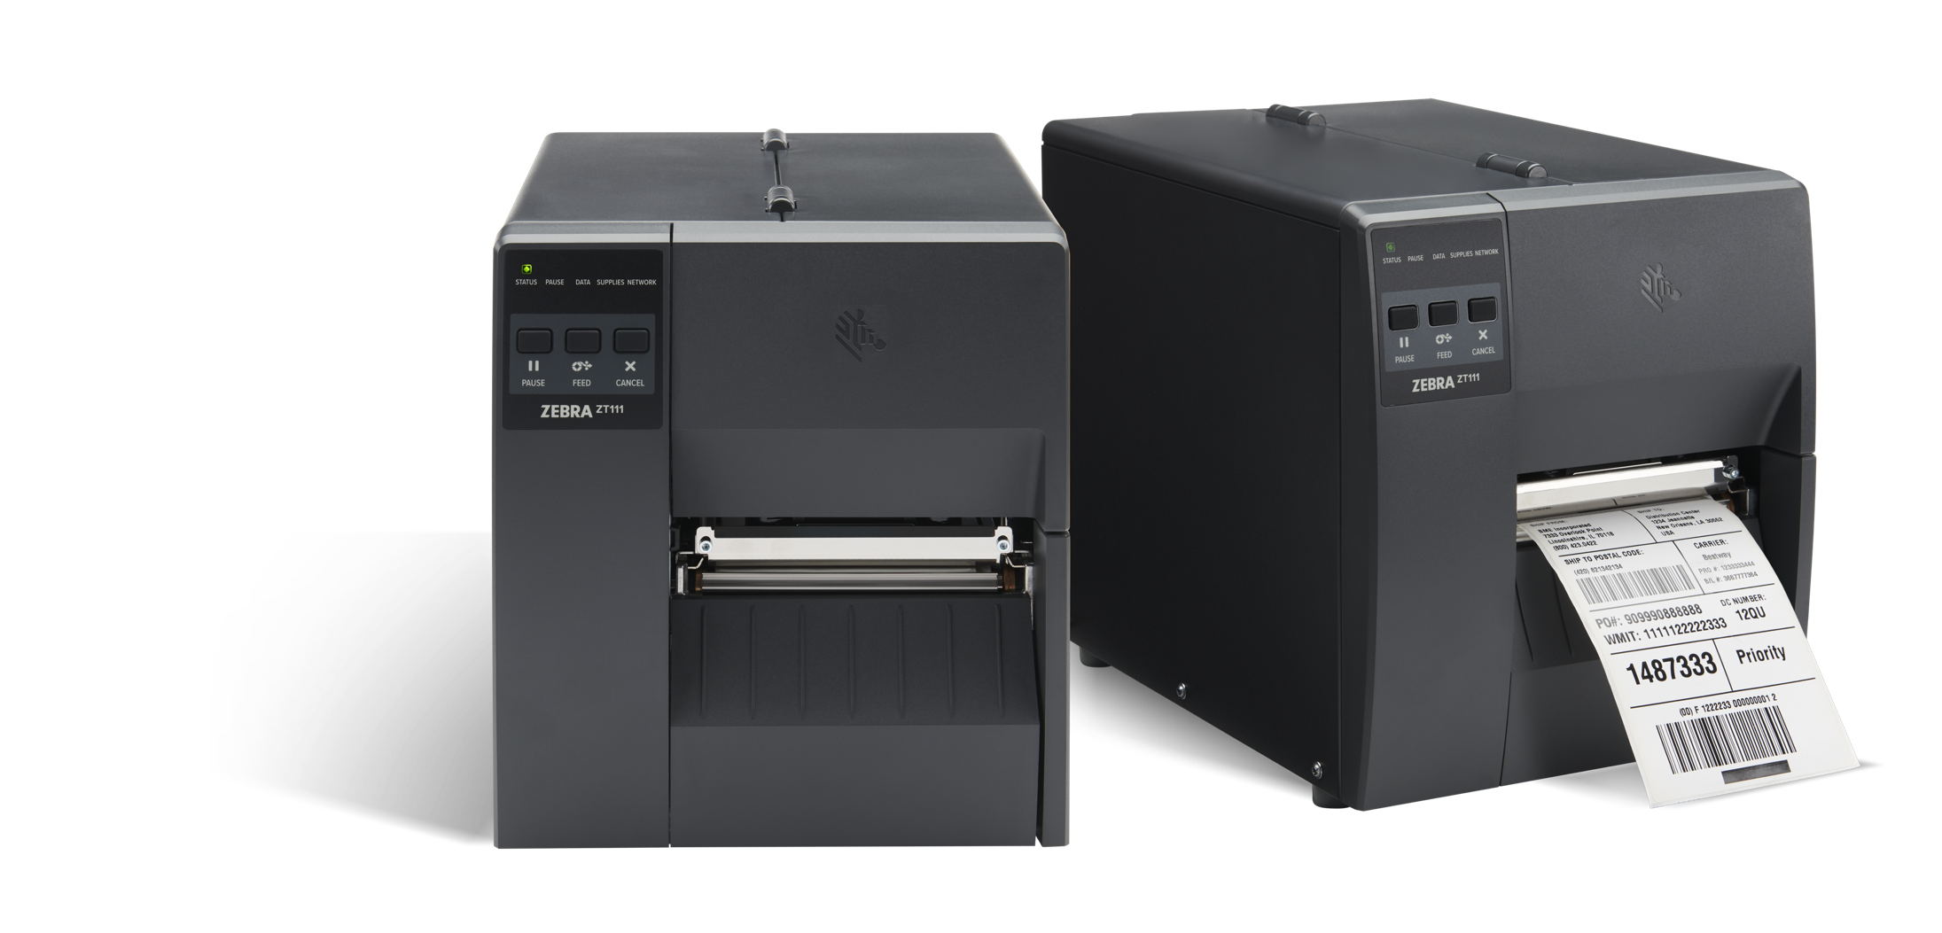
Budget Can Be Brilliant, Too
ZT111 Industrial Printer
Meet Zebra’s new entry-level printer: Small in price – big in performance
Presenter name
July XX, 2022

Slide 2
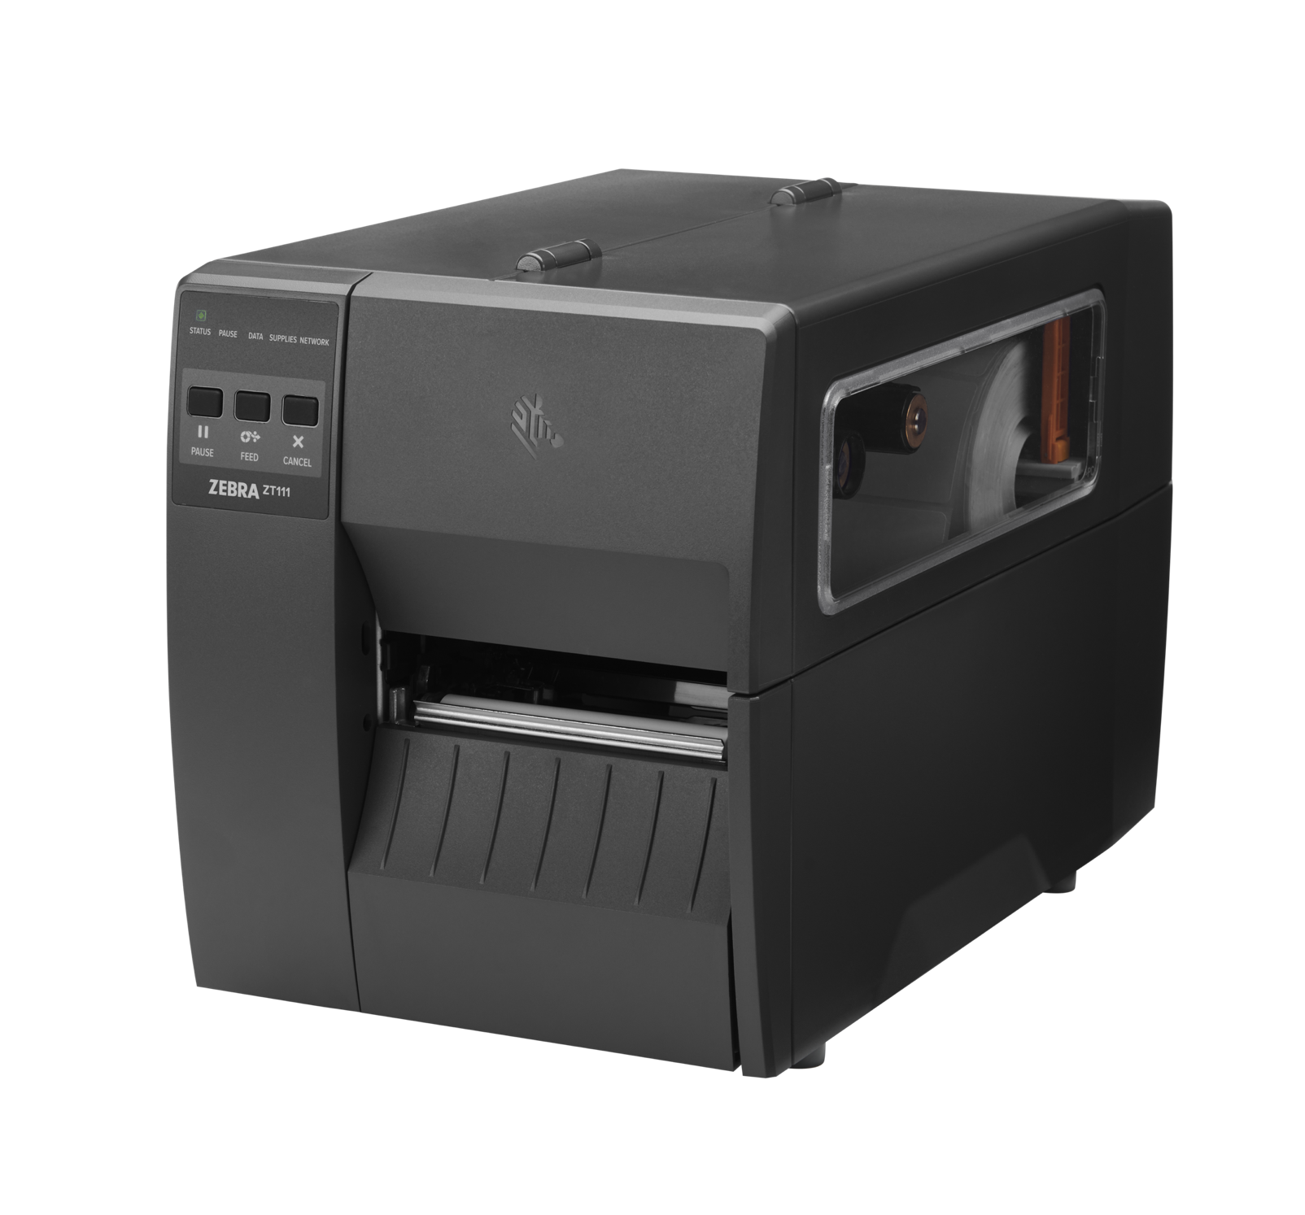
Agenda
Why Zebra?
The Business Challenge…
Introducing the ZT111 Printer
Vertical Markets
Key Features
Print DNA Basic Software
Supplies and Maintenance Plans

Slide 3
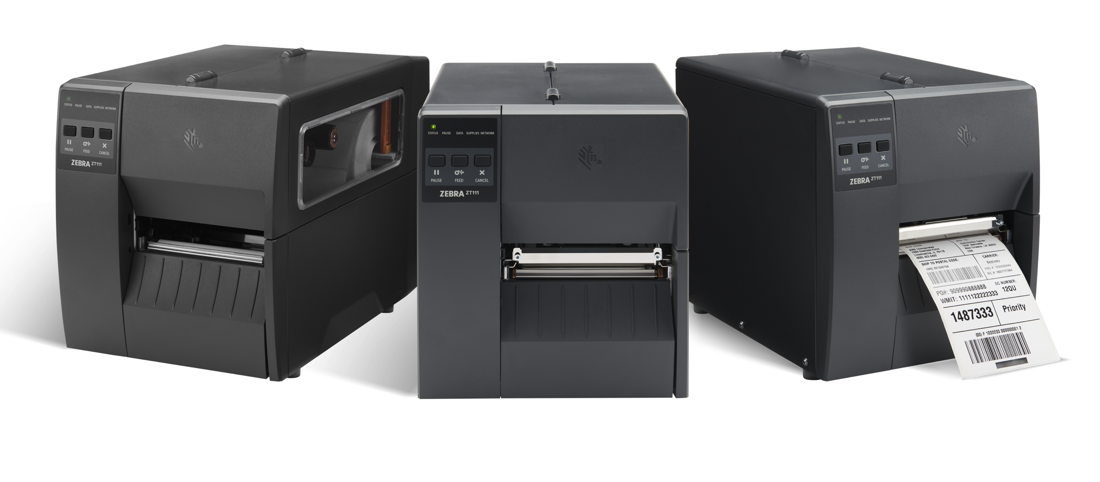
Why Zebra?

Slide 4

















Why Zebra?
Extensive reach
Scalable to meet any
enterprise demands
Leader status
Gartner Magic Quadrant for Indoor Location Services
Our people
make the difference
Channel
accolades
$4.5B
Global sales
#1
128+
Offices globally
Mobile RFID
5,300+
Patents issued and pending
Rugged mobile computing
8,800+
Employees worldwide
10,000+
Channel partners in over 100 countries
Data capture
$453M+
R&D* - *10% of Sales
Barcode printing
Sources: VDC Research and Zebra analysis (#1 market share), Gartner®, Inc., 2022 Gartner® Magic Quadrant™ for Indoor Location Services, Tim Zimmerman, Annette Zimmermann, 28 February 2022 (A Leader)

Slide 5
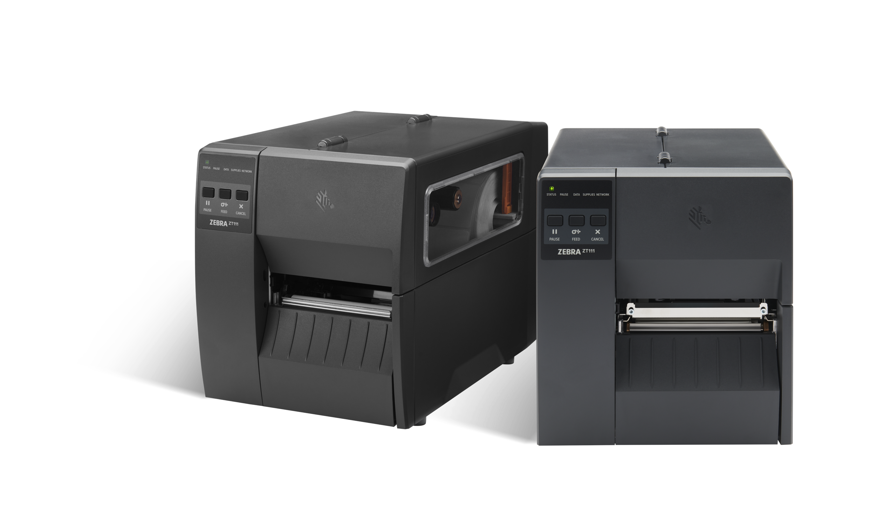
The Business Challenge…

Slide 6





Demands are rising
Volume is increasing
Timelines are shrinking
Transparency is expected
And, budgets are stretched
You Need a Reliable Printer
  With Industrial-Level Output
  that gives you the basics without the big-budget price tag

Slide 7
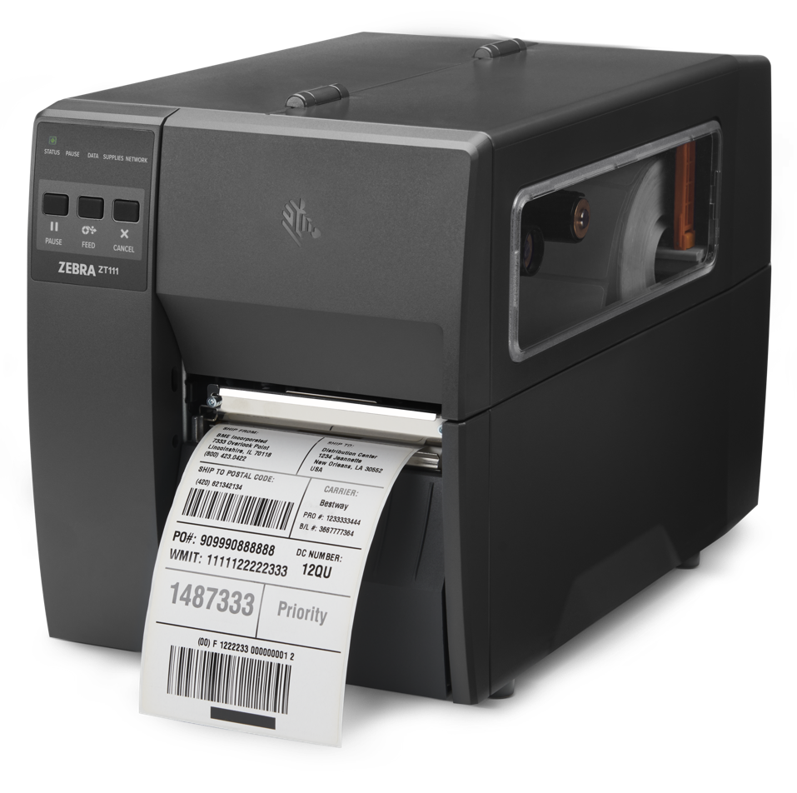
Go Industrial – While Still Staying in Budget
Get unparalleled performance, reliability and uptime for the long haul
See how the ZT111 printer brings you much more for much less
ZEBRA TECHNOLOGIES

Slide 8






Incredibly easy
to integrate, set up, operate and maintain
Small footprint
to help you make the most of your workspace
Smarter.
Smaller.
More Value.
Works your way
with just the right features and options
Durable construction
that’s built to last for years of hassle-free printing
  Get a Printer that’s Priced to Perform with Zebra’s ZT111 industrial printer
Future focused
with field-installable options and the ability to evolve
Smart settings
to add security and prevent tampering

Slide 9
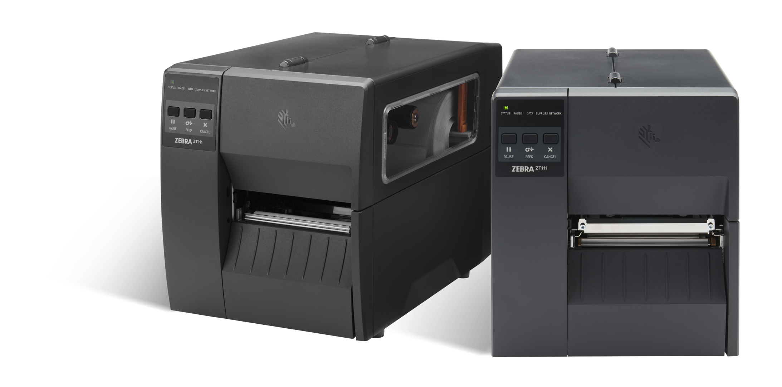
Ready to Meet Your
Light-Industrial Needs
Whatever Your Use Case

Slide 10

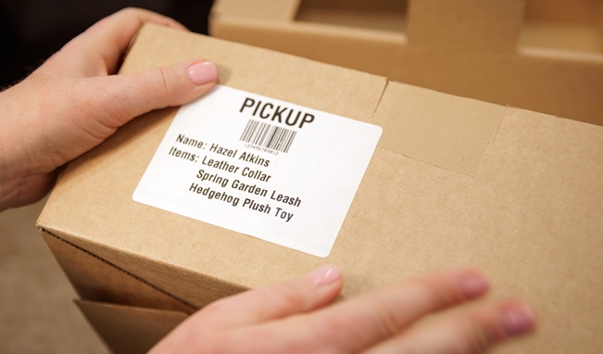
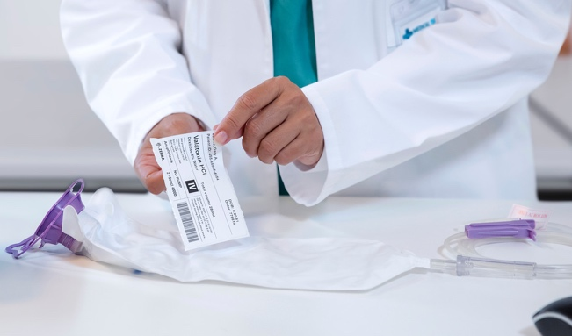
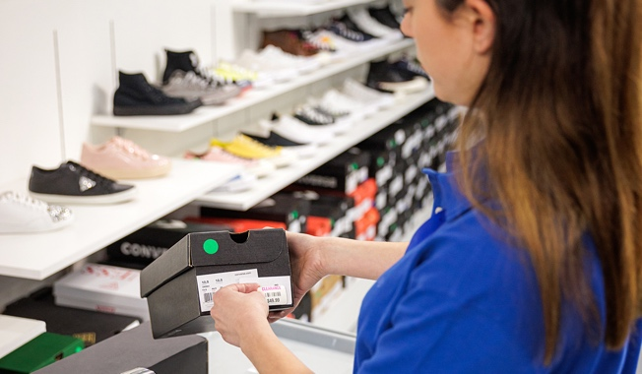





ZT111 Printer
Markets and Applications
Manufacturing
T&L
Healthcare
Retail
Work-in-process
Product ID/serial numbers
Packaging labeling
Receiving/put-away labeling
Order picking/packing
Shipping/receiving
Cross-docking
Compliance labeling
Laboratory labeling
Blood bank labeling
Asset tracking
Unit-dose labeling
Pharmacy labeling
Buy online pick up in store labeling
Return tagging
Price labeling
Shipping labeling

Slide 11
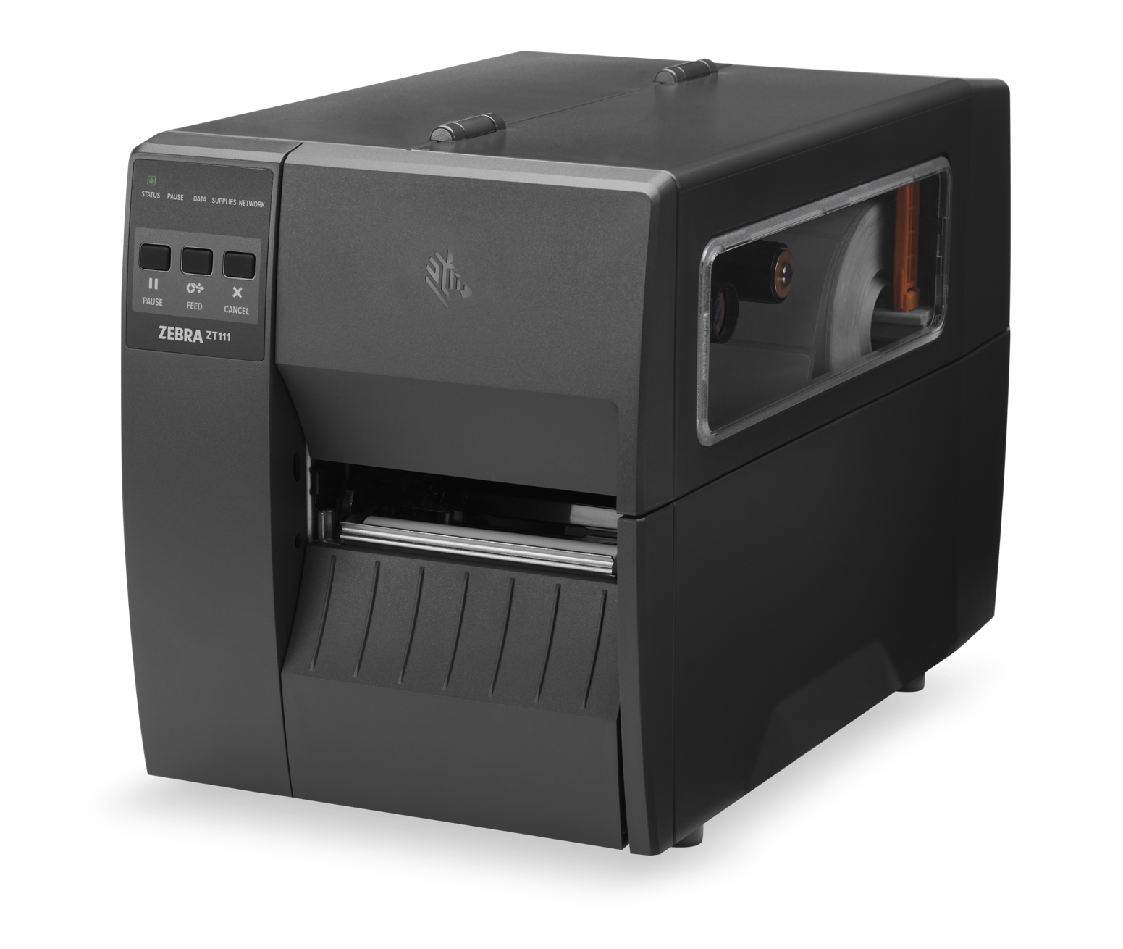
Key Features

Slide 12



ZT111
Integrate it your way with advanced connectivity options
Standard
Factory- or Field-Installable Options
Pair and Print
USB 2.0
Serial RS-232 Port
Ethernet 10/100
USB Host
Bluetooth® Low Energy
Print Touch (NFC) lets you tap a compatible mobile device to pair and configure/print using Zebra setup utility app
802.11ac Wi-Fi™ option card
2nd Ethernet 10/100
Connect your ZT111 to your existing wired or wireless network, or directly to any PC.
Notes:
USB 2.0, USB Host
Printer setup mobile app for Android & iOS via BTLE (Bluetooth Low Energy 5) connection*
* BTLE is provided for using with Zebra printer setup mobile app only

Slide 13
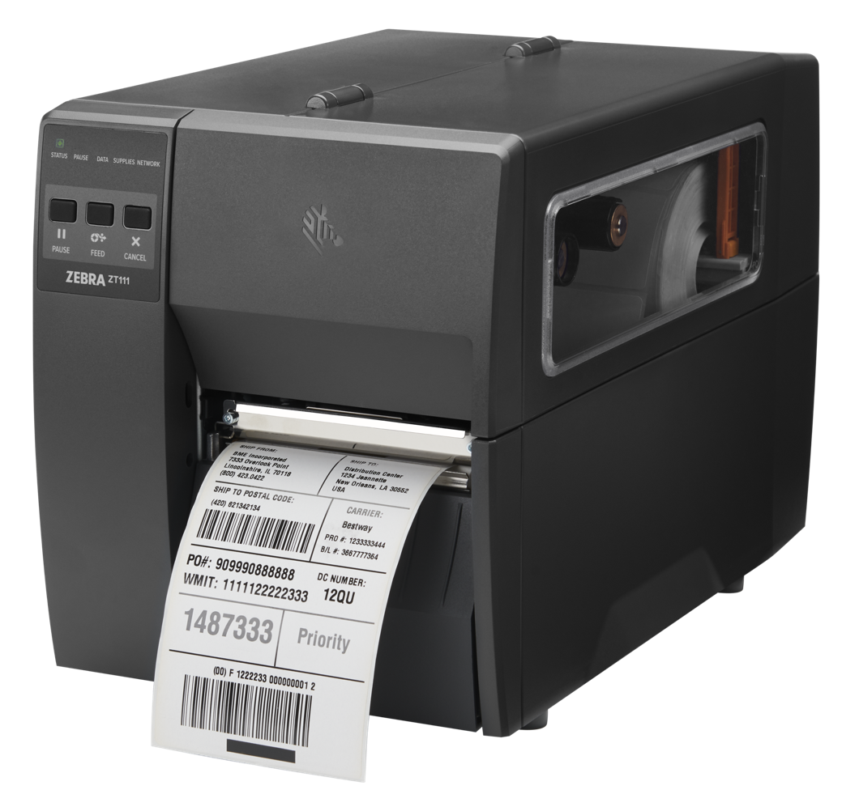
ZT111
Easy, flexible media loading
Simplify Media Loading
Broad Media Flexibility
    Guided, intuitive paths make loading media quick and easy
    Color-coded touch points
    Maximize uptime
    Large ribbon roll capacity
    Fewer media changes
    Fully adjustable sensors offer greater media flexibility
Field-Installable Media Handling Options
    Cutter
    Peeler

Slide 14

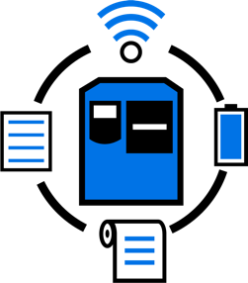

The ZT111 –
Zebra’s Most Affordable Industrial Printer
Just the Right Features, Just the Right Price
Space-Saving Footprint
Spend Less. Get More. Print Longer.
Multiple Connectivity Options
Protected Against Tampering

Slide 15
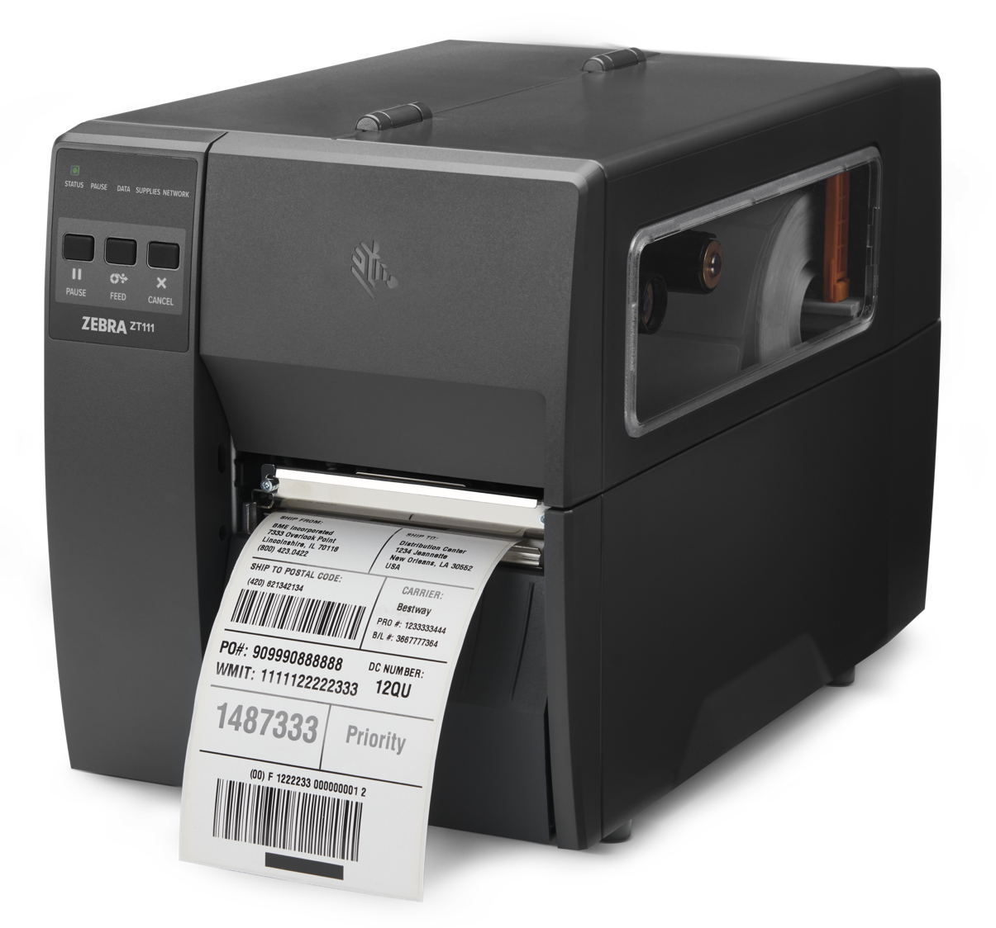
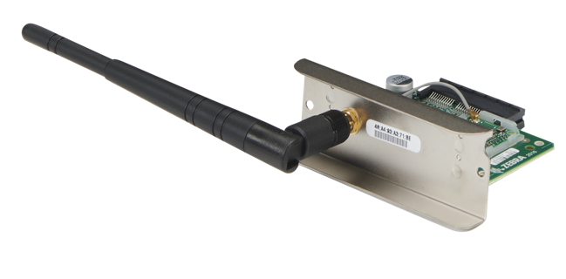
ZT111
Basic features with next-generation flexibility
Built to last with durable construction
Seamless integration into existing fleets
Intuitive interface with five LED icons that allow you to check status instantly
Powerful new architecture for faster processing
Guided paths for speedy media loading
Fast print speeds up to 10 ips at 203 dpi
Compact design
Easy to setup and use with Zebra’s Print DNA Basic apps for dependable printing
High-resolution 300 dpi print quality
Field-installable wireless kit with fast 802.11ac Wi-Fi
Evolves with your business needs

Slide 16

Print DNA Basic
Print DNA Basic Software will get your printer up and running quickly, deliver a dependable experience and enable your printer to evolve with your business needs.
Select Print DNA Apps for Added Intelligence
16

Slide 17



Protect Your Business from Damaging
Security Threats
Hackers are increasingly targeting networked thermal printers. Protecting your data is critical to preventing downtime and costly breaches. With our Print DNA Basic core suite of apps, you also get key printer security
features to help safeguard your infrastructure:
Protect your printer during boot-up
Ensure your printer is protected
during startup with Secure Boot
Evaluate your security against best practices
Compare your printer settings against best
practices with our free Security Assessment Wizard
Prevent tampering while in use
Protect your printer from unwanted
settings changes and updates while
in operation with Protected Mode
Customize for your needs
Adjust your security levels based on your
company needs using Zebra Secure Commands
Relocate and retire without worry
Reset all user settings and remove user files and data with Simplified Printer Decommissioning
A leader in secure enterprises technology
Rely on Zebra’s Partners and Professional Services to help identify security risks

Slide 18
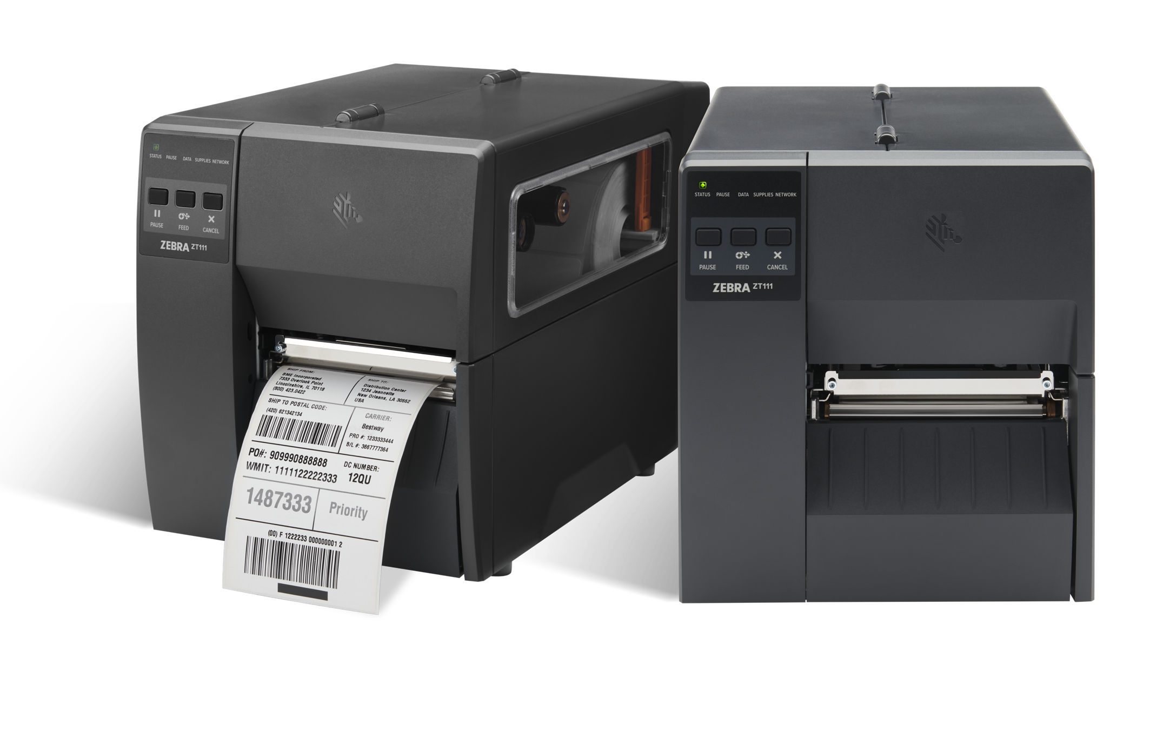
Supplies and Maintenance Plans
Supplies and Support – from the Source

Slide 19
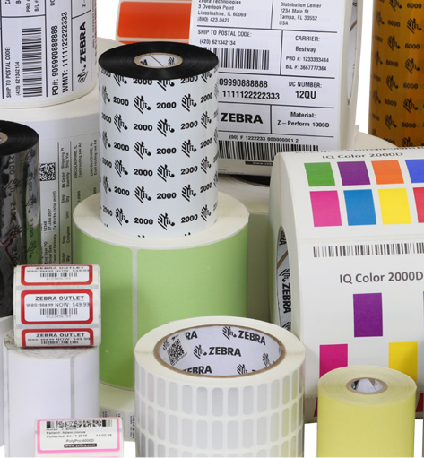





Print Confident. Print Quality.
Print Zebra.
Printer Up Time
No supply-related downtime
Workforce Productivity
Increased worker and process efficiency
Customer Service Quality
No delays related to printer supplies
TCO
Reduced capital, operational, maintenance and troubleshooting costs
Every year you spend
3 to 10 times the cost
of your Zebra printer on printing supplies

Slide 20



Portfolio
There’s a Zebra service plan to fit every need
Comprehensive repair services
3-day repair turnaround time
8x5 local time technical support
3- or 5-year coverage
Optional Visibility Services
Comprehensive repair services
Advance replacement
24x7 technical support
3- or 5-year coverage
Spare pools management
Device commissioning
Optional Visibility Services
ZEBRA TECHNOLOGIES

Slide 21
Better, smarter printing –
with Zebra
Thank you
For more information, visit, www.zebra.com/zt111

Slide 22

Maximize device uptime and performance with our core Zebra OneCare offering
  What It Is
  Basic assurance with comprehensive coverage and fast repair and return times.
  What You Get
Comprehensive Coverage: If it’s broken, we fix it
  Includes normal wear and tear and accidental damage
8x5 local time live-agent technical support and 24x7 access to self-service tools
Priority repair turnaround time: 3-day depot repair
VisibilityIQ OneCare
3- or 5-year coverage plans
  Available For
  Zebra printers, mobile computers and scanners.
ZEBRA TECHNOLOGIES

Slide 23

Maximize device availability and ROI with our highest level of care
  What It Is
Builds on Zebra OneCare Essential, offering expanded support hours, advanced device replacement and more.
  What You Get
Comprehensive Coverage: If it’s broken, we fix it
  Includes normal wear and tear and accidental damage; eliminates unpredictable and
  unexpected device repair-related costs
Advanced Device Replacement via next business-day delivery
  When you report a malfunctioning device, we ship a commissioned and ready-to-go
  replacement device the same day for next-business-day replacement
24x7 live-agent technical support
VisibilityIQ OneCare
3- or 5-year coverage plans
  Available For
  Zebra printers, mobile computers and scanners.
ZEBRA TECHNOLOGIES

