Slide 1
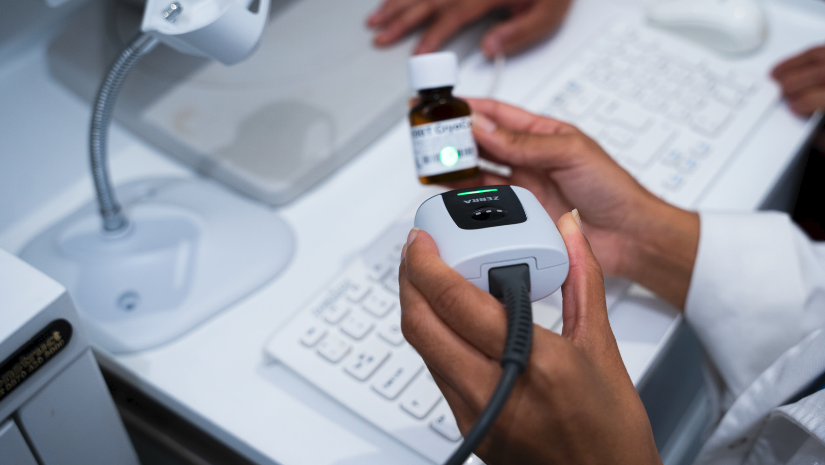

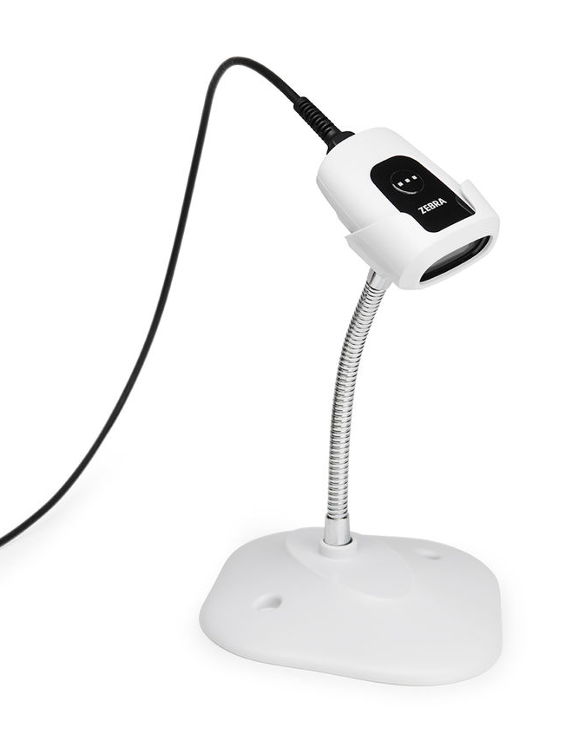
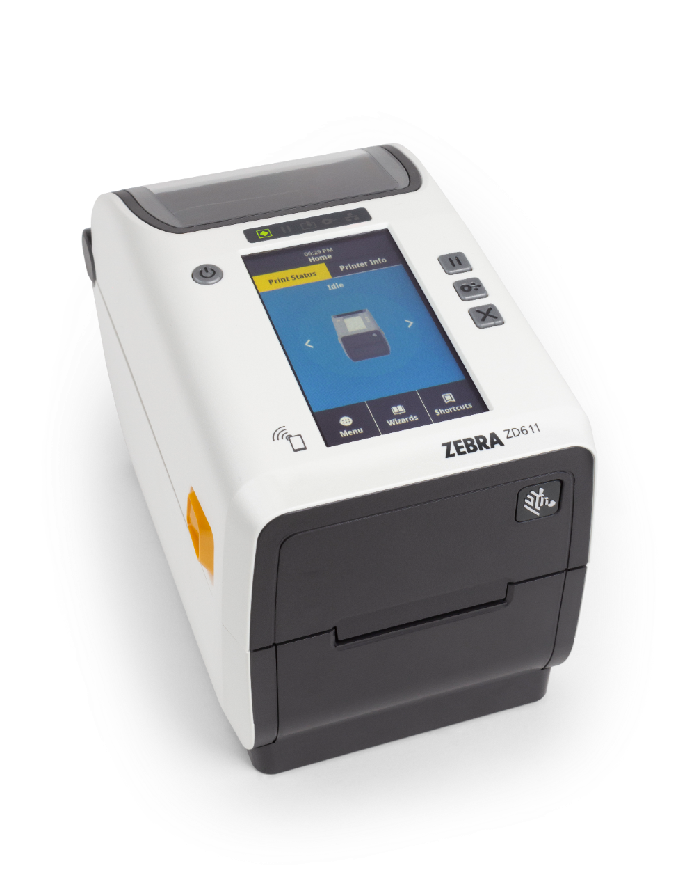
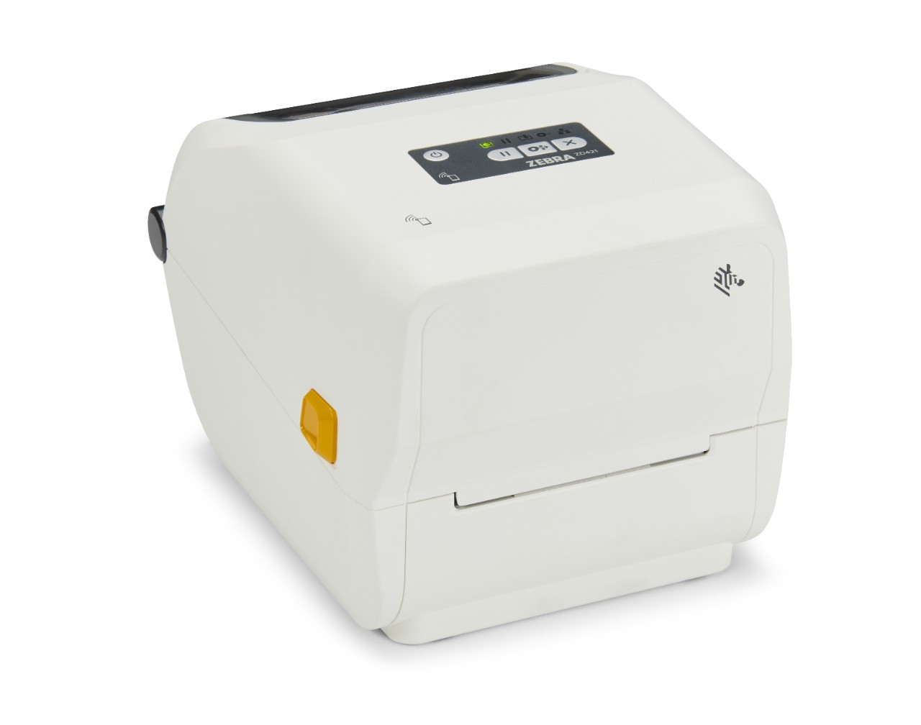
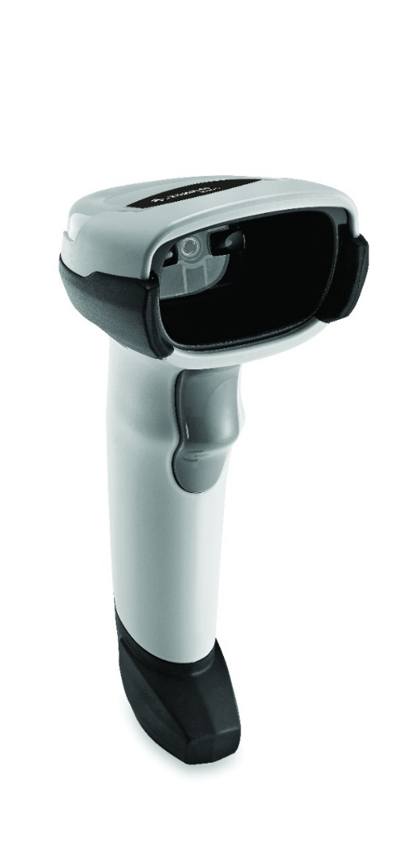
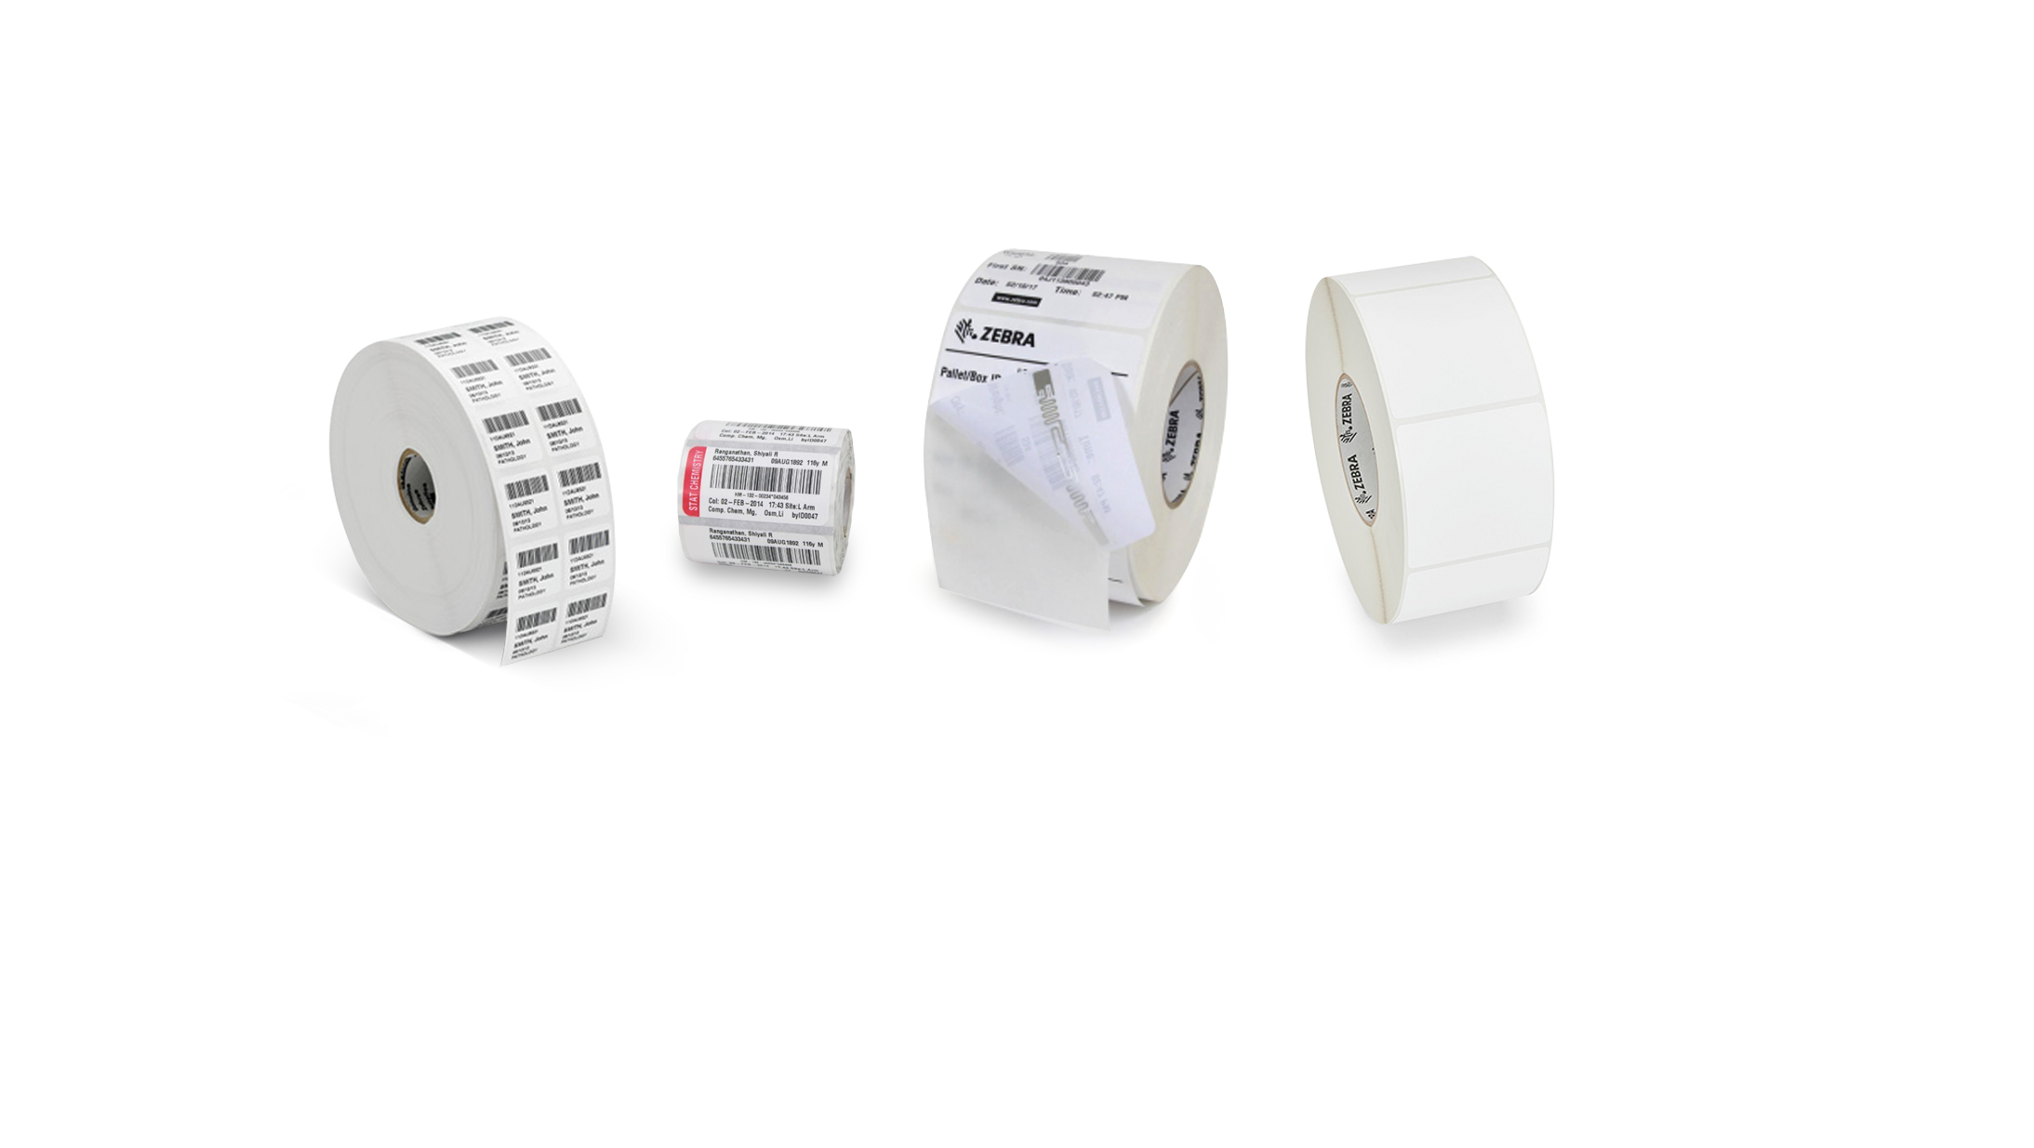
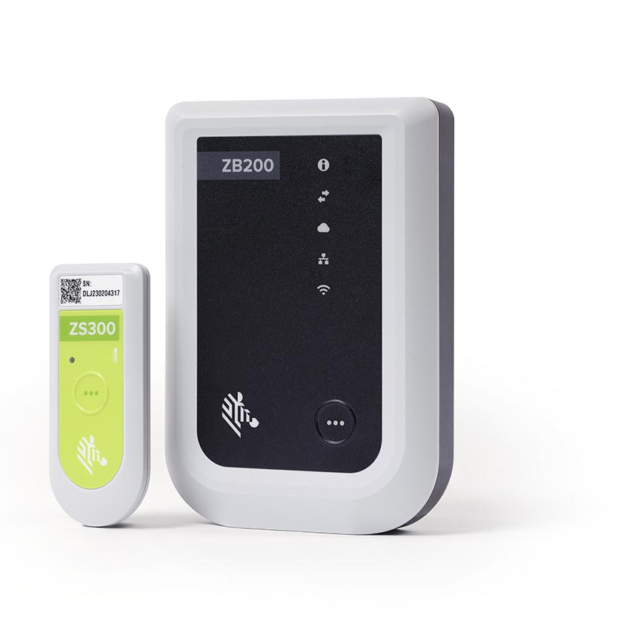
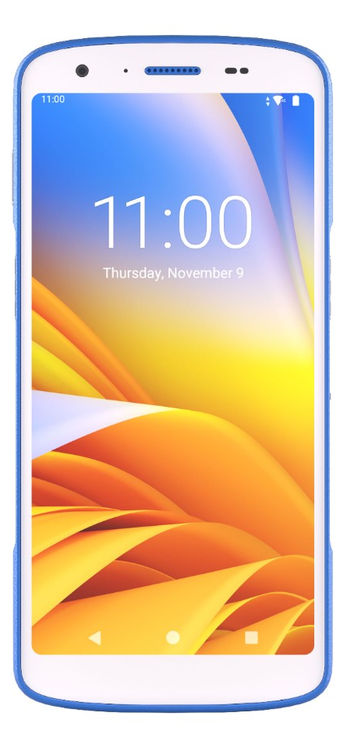
Barcodes and the Pharmacy a perfect match
Streamline Operations and Enhance Accuracy
Poor inventory management and inaccurate dispensing in pharmacies is both expensive and can put patients at risk. Zebra label printers, barcode scanners, mobile computers, temperature sensors, labels and software solutions improve pharmacy management and reduce errors.
Streamline medication tracking
Drive optimal pharmacy management
Promote error prevention
Increase dispensing accuracy
Enable temperature visibility

Slide 2
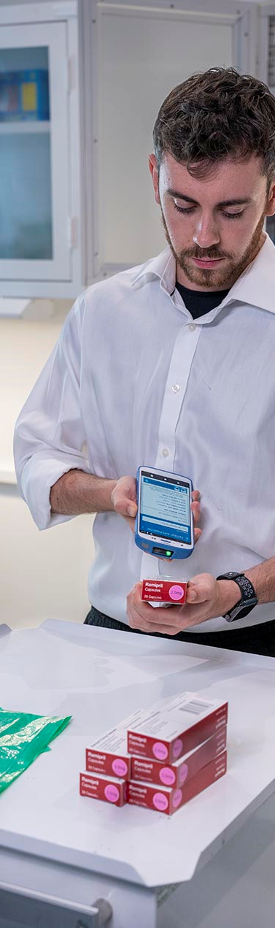
Reduce errors and give your patients a virtual voice through barcode technology, and purpose-built solutions
To maximize patient safety and improve care quality it is essential that the right processes are in place to ensure the right medications are provided to the right patients.
Barcoding identifies medications at the unit-dose level for dispensing and administration, putting patient safety at the forefront by providing a “virtual voice” to patients, applications and workflows.
Zebra pharmacy solutions provide products and software built for the unique demands of pharmaceutical environments.
Enhance patient care and safety
  Reduce preventable clinical errors and stop the spread of germs
  Precisely track patients, medications, medical devices, and lab samples required for patient safety
  Monitor temperature to ensure quality
Manage the supply chain
  Boost accuracy of supplies tracking and inventory management
Reduce labour shortages, fatigue, and burnout
  Technology is essential to improving operational efficiencies and workflows
Meet compliance requirements
  Use of technology greatly enhances ease of compliance
For more information on Zebra Pharmacy Solutions, visit Zebra.com
ZEBRA and the stylized Zebra head are trademarks of Zebra Technologies Corp.,
registered in many jurisdictions worldwide. ©2024 Zebra Technologies Corp. and/or its affiliates.

